Slide 1

A Miser’s Guide to
HARDENING
ACTIVE DIRECTORY
BSIDESKC 2026
TYLER JACOBS | POOLMANJIM
Notes:
Hello and good afternoon. I hope you have all had a good day.
I'll be discussing Miser's Guide to Hardening Active Directory. If you're here for something else, you're in the wrong room. For those of you here on purpose, thanks for coming!
This is my first conference talk. I also got a C+ in Public Speaking so you're all in for a treat! And I have ADHD so expect a ride!
-- REFERENCE --
https://learn.microsoft.com/en-us/windows-server/identity/ad-ds/plan/security-best-practices/best-practices-for-securing-active-directory

Slide 2

\> INVOKE-WHOAMI
Name = Tyler Jacobs
Alias = Poolmanjim, ActiveDirectoryKC
Job = @{
Title = Principal Security Engineer - Identity
Organization = Type.UndisclosedHealthCare
Experience = Get-Random -Min 15 -Max 20
}
Contact Info = @{
Discord = @poolmanjim
Website = activedirectorykc.net
github = github.com/ActiveDirectoryKC
Reddit = u/poolmanjim
}
Interests = Identity, Homelab, TTRPGs, Gaming
BSIDESKC 2026
TYLER JACOBS | POOLMANJIM
Notes:
So, who am I?
I’m Tyler. In most circles online I go by Poolmanjim.
I’ve been in IT for about 20 years with just over half of that in identity, mostly on-prem AD.
I’m a Principal Engineer at a large health org that I’m not naming. It’s not secret, just keeping things simple.
I have been a moderator of reddit’s r/ActiveDirectory for awhile. Check us out sometime but mostly check out the wiki. It has tons of resources.
My contact details on are screen, but they'll be at the end too.
-- OTHER --
I'm very much an on-prem guy still who embraces the cloud but wants to use it sensibly. I'm also super sketchy of AI.
I have a family, a wife and two young boys. That's fun and for fun I like tinkering with my lab, playing games, especially D&D, but I'm not picky about the game. No I probably haven't played the game your thinking of. :)

Slide 3
WHAT’S THIS ALL ABOUT?
Active Directory Is not dead!
CHEAP
Security isn’t free.
We have to start somewhere.
GOOD
FAST
BSIDESKC 2026
TYLER JACOBS | POOLMANJIM
Notes:
Show of hands: Who in here expects AD to not be a thing anymore in 10 years?
[RESPOND]
[slide]
Most organizations that have Active Directory aren't expecting to get rid of it any time soon, so we must support it. [slide]
A challenge we experience is that maintaining and securing a system both have costs and they may be competing.
It exists and we must secure it, but security isn't free. So, what do we do? [slide]
The whole goal of this talk is simple: "The hardest part of any important task is getting started on it in the first place. ."
The plan is to give some rough steps, not the details, but places to start and actions to take that will get you started making your AD better. I won’t be going into super detail or doing deep dives. I’ll focus on actionable, hopefully affordable, and accomplishable goals to make your AD better. Rather than focusing on projects that will languish for years, the elements I'll cover are pointed and actionable to get real gains in the real world.

Slide 4

DISCLAIMERS / WHAT IS THIS NOT?
Tools may trip EDR/AV...
Most Tools Free - some aren’t
I don’t work for them
Free tools often require emails*
Not an exhaustive list
Opinions are mine
BSIDESKC 2026
TYLER JACOBS | POOLMANJIM
Notes:
Disclaimers first.
[slide]
The tools, scripts, and applications I mention are tools that tend to overlap with redteamers/bad guys. There is a chance they'll trip EDR and monitoring. Make sure you coordinate with your SOC
[slide]
I don't work for any of these tools or vendors. Most of the tools are free, some aren't as free. Point is. They're not my work just things that have stood out to me over the years.
[slide]
Tools may ask for emails. You can get around that using the temp email tools. It's up to you. If i can I provide email-free links.
[slide]
This is not an exhaustive list. I could spend weeks talking about AD Hardening. I have 50 minutes. I have lots of notes and bonus slides in the deck to help more.
[slide]
Any opinions here are mine. My employer had nothing to do with this so blame me not them.

Slide 5

BONUS
Getting started with AD
BONUS SECTION
BSIDESKC 2026
TYLER JACOBS | POOLMANJIM
Notes:
Let's see hands: Who here has backups?
Okay, who here has tested and validated a full forest recovery in the last year?
Yeah get on that.
BCDR is kind of boring. That's probably the reason it doesn't get a lot of love at talks.
You get backups. If you're smart you test backups. You forget you have backups. Maybe your org does yearly tabletops.
They're not shiny or cool. But they are essential. This section may be my most important for that reason alone!
-- REFERENCES --
https://learn.microsoft.com/en-us/windows-server/identity/ad-ds/manage/forest-recovery-guide/ad-forest-recovery-guide

Slide 6
BONUS
BONUS - Beginner’s References
Free Training
Antisyphon - From Zero To Hero https://www.youtube.com/watch?v=XwOV7HpVLEA
MS Learn - Active Directory Domain Services https://learn.microsoft.com/en-us/training/paths/active-directory-domain-services/
MS Learn - Administer ADDS https://learn.microsoft.com/en-us/training/paths/administer-active-directory-domain-services/
MS Learn - Deploy and Manage Identity Infrastructure https://learn.microsoft.com/en-us/training/paths/deploy-manage-identity-infrastructure/
Guides / Lab Guides
MS Learn - Install AD Domain Services https://learn.microsoft.com/en-us/windows-server/identity/ad-ds/deploy/install-active-directory-domain-services--level-100-
MS Zero Trust Lab (VS Sub Suggested) https://microsoft.github.io/cloudlab/
LUDUS https://docs.ludus.cloud/docs/intro
BSIDESKC 2026
TYLER JACOBS | POOLMANJIM
Notes:
BONUS - Beginner References
Here are some great getting off the ground resources with Active Directory. All of these are pulled from the r/ActiveDirectory wiki so I encourage you to look there too.
Reddit - AD Wiki Beginners Guide https://www.reddit.com/r/activedirectory/wiki/ad-resources/ad-beginners-guide/ Reddit - AD Wiki Index
https://www.reddit.com/r/activedirectory/wiki/index/
The free trainings are good videos/trainings that cover the basics of AD in a meaningful way.
Antisyphon - From Zero To Hero https://www.youtube.com/watch?v=XwOV7HpVLEA
MS Learn - Active Directory Domain Services https://learn.microsoft.com/en-us/training/paths/active-directory-domain-services/
MS Learn - Administer ADDS https://learn.microsoft.com/en-us/training/paths/administer-active-directory-domain-services/
MS Learn - Deploy and Manage Identity Infrastructure https://learn.microsoft.com/en-us/training/paths/deploy-manage-identity-infrastructure/
I also see a lot of questions on how to build an AD Lab. Here are some great references on where to start with that.
MS Learn - Install AD Domain Serivces https://learn.microsoft.com/en-us/windows-server/identity/ad-ds/deploy/install-active-directory-domain-services--level-100-
MS Zero Trust Lab (VS Sub Suggested) https://microsoft.github.io/cloudlab/
LUDUS https://docs.ludus.cloud/docs/intro

Slide 7
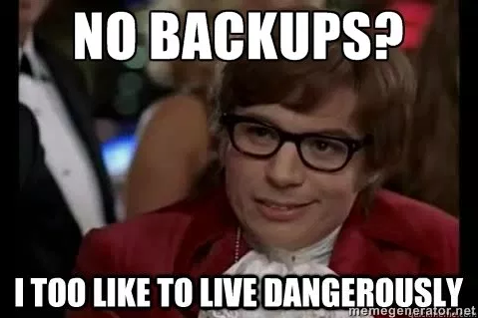
THE GHOST OF BACKUPS ARE EXPENSIVE
Business Resilience & BCDR
BSIDESKC 2026
TYLER JACOBS | POOLMANJIM
Notes:
Let's see hands: Who here has backups?
Okay, who here has tested and validated a full forest recovery in the last year?
Yeah get on that.
BCDR is kind of boring. That's probably the reason it doesn't get a lot of love at talks.
You get backups. If you're smart you test backups. You forget you have backups. Maybe your org does yearly tabletops.
They're not shiny or cool. But they are essential. This section may be my most important for that reason alone!
-- REFERENCES --
https://learn.microsoft.com/en-us/windows-server/identity/ad-ds/manage/forest-recovery-guide/ad-forest-recovery-guide

Slide 8
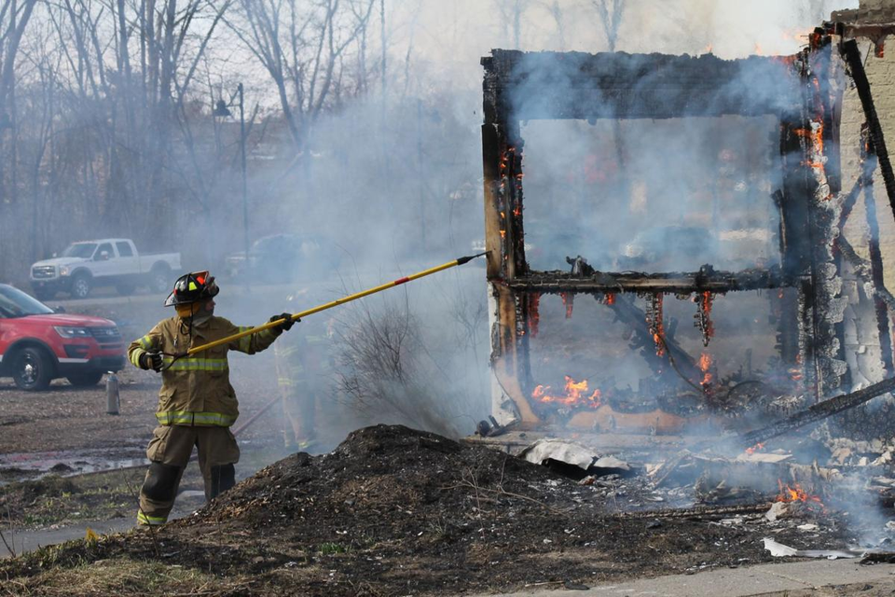
WHY ARE BACKUPS IMPORTANT?
Go from “Oh S***” to “Okay?”
BSIDESKC 2026
TYLER JACOBS | POOLMANJIM
Notes:
Why are backups important?
[slide]
They get you from "Oh crap!" to "Okay".
[slide]
We often think of BCDR like this. A building burns down, a comet hits the building, etc. In fact most organizations are fairly well prepared for those contingencies. Insurance companies are prepared for those.
[slide]

Slide 9
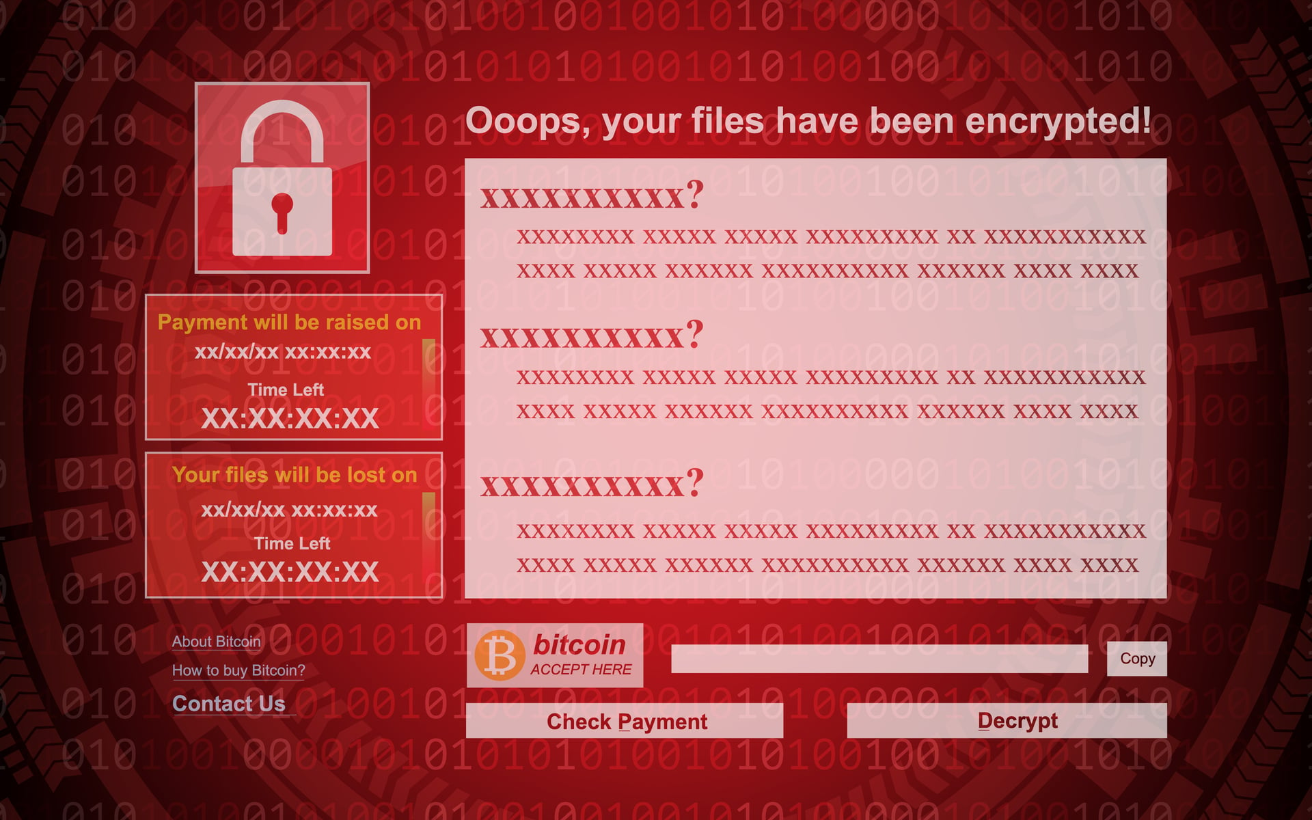
RED SCREEN OF “F***!””
Notes:
What happens if you log in and see this screen on your systems? Worse what if you see it on your domain controllers?
Where do you go from there?
I can tell you that your EDR may not stop this from happening.
There are not any guarantees on this red screen. It's not like the malware guys sign up for the BBB.
Think about this: If the entire identity system is down, what can you do? No email. No teams. Phones may not work. What do you do?
You have to have options.

Slide 10
GET ENTERPRISE BACKUPS
GOOD BACKUPS COST $$$
Are they worth it?
YES!
Support
Insurance
Features
BSIDESKC 2026
TYLER JACOBS | POOLMANJIM
Notes:
When talking about options, there is some bad news. Good backups cost. Backups have to be good, and they have to be fast, which means they're going to cost.
[slide]
Is the cost of your entire IT budget for that year worth it?
[slide]
100%. Yes. Absolutely!
The main reason for this is the first bullet.
SUPPORT!
When you're down, your job is on the line, everyone's yelling, etc. it is crucial to be able to offload some of that stress. Having a vendor to call to help you will make the whole process go faster!
There are other benefits, you have the insurance that someone else did some of the work and you get features which most free tools don't have, but support is your win with BCDR.
The tool is important. You want your BCDR tool to be usable, but that is actually not the most important reason to buy a solution.
Don't get me wrong, there are workable cheaper/free options. I argue this is the hill worth dying on.

Slide 11
BONUS
BONUS - Snapshots and AD
AD Replication Consistency 101
AD and Snapshots
Update Sequence Number (USN) = How AD tracks changes
Unique to Every DC
Never goes down. Only up.
If it goes down = USN Rollback = Replication stops
Server 2012 introduced VM Generation ID
VM Generation ID associated with Hypervisor
Most supported.
Some don’t support this = Risky
Change in VM Generation ID = Change to Invocation ID
No USN Rollback
Still kind of risky with AD to do snapshots
Snapshots and USN Rollbacks
Snapshots capture a single moment
Rollback is to that moment
USNs rollback too.
USN Rollback happens
Conventional Backups and Rollback
Traditional backups change Invocation ID.
Invocation ID + USN = Unique Replication instance
No USN Rollback
Notes:
BONUS - AD and Snapshots
I said earlier that Active Directory doesn’t like snapshots. What did I mean?
Quick View of AD Replication Consistency
AD is a replicated database and normally domain controllers are writable copies of this database. The only exception to this is Read-Only Domain Controllers (RODCs) which aren’t in scope for this.
AD maintains consistency of this replication through an attribute attached to every object and attribute in Active Directory. This is called the update sequence number (USN). Each domain controller maintains its own USN and as they replicate, they share their highest committed USN with each other which is then stored. When a change is made on one domain controller it advertises this change (via a process called Change Notification) to nearby domain controllers (There is more to it than that, but we’re simplifying). The receiving, or replica, domain controllers check against USNs they’ve received. If it is newer, the DC will say “send me the changes since xyz” and replication happens. If it is the same, the receiving DC doesn’t ask for anything.
The USN value should NEVER go down. It should only ever go up. The only way it can go down is if the Active Directory database is reset somehow.
Snapshots and USN Rollbacks
Snapshots capture a moment in time. When you roll back a snapshot, you roll back to a moment in time. If there were pending replications or new changes after the snapshot rollback. the originating DC would send information about these changes to the replica DCs they talk to. These replicas would immediately recognize that the USN rolled back, and they would stop all replication from that DC. This can cause a ripple in the domain that leads to a total replication stoppage and requires significant work to remedy.
Restoring AD Conventionally
But wait, if I restore from backup doesn’t that trigger a USN rollback? No.
Firstly, restoring from a backup does not include any pending replications.
Second, when a backup is restored, AD detects this (if it is done using the proper methods) and changes the AD Database Invocation ID which is its way of tagging the database for consistency. This effectively changes how the USNs are calculated and new USNs will be issued from that DC for its changes going forward. This avoids the USN rollback situation.
AD and Snapshots
In Server 2012 Active Directory did introduce a change to how it handles all of this. If it is a virtual domain controller on a supported hypervisor the domain controller also tracks something called a VM Generation ID. This value is unique to the hypervisor + domain controller combo. If you snap DCs on a supported hypervisor and restore that snap, that generation ID is passed along and used to alter the database invocation ID and thus USN rollback is avoided.
Most mainstream hypervisors support VM Generation ID, but some smaller ones don’t. So, keep an eye on that. Hyper-V and VMWare 100% do. I believe Proxmox and Nutanix do. The others I cannot be sure about.
The only other supported scenario with snapshots is if you were to snap all the domain controllers at the same time and restore from the same snaps all at once if you needed to roll back. Otherwise, you could risk USN rollback.
Because of this weirdness, it is a general recommendation of mine to avoid snapshotting domain controllers in production. There are too many risks for it to be worth it. This is also why your backup solution needs to be AD-aware — a generic file or block backup that doesn't trigger the proper restore path won't get the Invocation ID reset, and you're back to the same USN rollback problem.
-- REFERENCES --
https://learn.microsoft.com/en-us/windows-server/identity/ad-ds/get-started/replication/active-directory-replication-concepts
https://learn.microsoft.com/en-us/windows-server/identity/ad-ds/manage/powershell/introduction-to-active-directory-replication-and-topology-management-using-windows-powershell--level-100-
https://learn.microsoft.com/en-us/troubleshoot/windows-server/active-directory/detect-and-recover-from-usn-rollback
https://adsecurity.org/?p=515
https://learn.microsoft.com/en-us/archive/blogs/reference_point/usn-rollback-virtualized-dcs-and-improvements-on-windows-server-2012

Slide 12
BONUS
BONUS - Backups 101
Backup Types and Terms
Bare Metal Recovery (BMR)
BMR backups are copies of the whole disk, boot sector, etc.
System State (SS)
SS backups are more like copies of the operating system and critical files.
Includes AD DB and Sysvol.
Not a true BCDR solution.
Full Backup
A complete backup.
Not confused with BMR.
Incremental Backups
“Delta” backups. Only copy what’s changed since last backup.
Not recommended. Restore Chain Dependencies
Differential backups
Similar to incremental, except are bound to a full backup.
Still not recommended. Restore Chain.
Notes:
BONUS - Backups 101
This slide is jus some quick guides to some of the terms used with backups. It is not intended to be a full slide to be presented.
Backup Types
Bare Metal Recovery (BMR).
This is a complete copy or clone of the system disks at the block/sector level. This is a nothing shared backup. The idea here is you capture everything.
These can usually be used to restore from catastrophe and for AD have been the go-to backup solution as they allow for full loss to be restored from.
The downside is that being a full disk-level copy is that any embedded or hidden malware will be captured and restored. This can lead to re-infection if not careful.
Until modern, IFM-based, backups this was the only way to do a full end-to-end forest recovery.
System State (SS)
System State Backups are more just copies of the OS information and critical data. They don’t include all the files and applications and focus on “important” elements.
The downside is they don’t capture the full system information so you cannot easily restore system state backups onto a new VM image. It requires a “surviving” VM to restore to.
Another downside is they still have the possibility of embedded malware and reinfection.
The biggest advantage is they are smaller in size than BMR.
Ultimately, on their own they are not a true BCDR solution for AD.
Backup Methods
Full Backup.
This is a complete BMR or SS backup job. This has all the files for the job and is a full version of what was supposed to be backed up.
Most backups are Full backups.
Use these kinds of backups whenever possible.
Incremental Backups
These are delta backups that are linked to a full backup. The full backup runs say once a week and the incremental runs every day.
The idea is that this reduces the storage demand as the incremental only capture what’s changed.
The challenge is this introduces dependencies and you must have every backup in the chain to recover in a lot of situations.
Not generally recommended.
Differential backups
Very similar to Incremental.
Difference is incremental can chain off each other where differential ties back to a full backup.
Has the same challenge as incremental and only is slightly better.
Still not recommended.
-- REFERENCES --
https://learn.microsoft.com/en-us/azure/backup/backup-mabs-system-state-and-bmr
https://learn.microsoft.com/en-us/windows-server/identity/ad-ds/manage/forest-recovery-guide/ad-forest-recovery-backing-up-a-full-server
https://learn.microsoft.com/en-us/windows-server/identity/ad-ds/manage/forest-recovery-guide/ad-forest-recovery-guide
https://learn.microsoft.com/en-us/windows-server/identity/ad-ds/manage/forest-recovery-guide/ad-forest-recovery-determine-how-to-recover
https://www.semperis.com/blog/best-practices-active-directory-backup/

Slide 13
FINDING A GOOD SOLUTION
Business Requirements
Business Tolerance?
What are you protecting against?
BSIDESKC 2026
TYLER JACOBS | POOLMANJIM
Notes:
When analyzing any solution we have to keep in mind what our target or goals are.
Start with business tolerance.
How many days or weeks back do we need to be able to restore to? Keep the AD tombstone lifetime in mind here.
Also consider how much lost data is “acceptable”. Leaders love to say like “no loss” or “zero downtime”, which are great to say in a mirror but don’t help us. Find real numbers.
What are we protecting against?
If your org only cares about natural disasters, focus on that first.
Personally, I start from the red screen of “F”.
[slide]

Slide 14
RECOVER NETWORK
FINDING A GOOD SOLUTION
RECOVER COMPUTE
Business Requirements
Business Tolerance?
What are you protecting against?
CONNECT STORAGE
(BACKUPS)
Technical Musts
Can it restore? AD?
RECOVER AD
RCA
RECOVER APPS
BSIDESKC 2026
TYLER JACOBS | POOLMANJIM
Notes:
Of course we need technical requirements.
If it can’t restore, it’s a pointless tool. Make sure it can restore your entire AD.
Also, this is a good place to mention, make sure when you are backing up AD that you’re backing up multiple domain controllers.
[slide]

Slide 15
RECOVER NETWORK
FINDING A GOOD SOLUTION
RECOVER COMPUTE
Business Requirements
Business Tolerance?
What are you protecting against?
CONNECT STORAGE
(BACKUPS)
Technical Musts
Can it restore? AD?
RECOVER AD
Can it be secured?
RCA
RECOVER APPS
BSIDESKC 2026
TYLER JACOBS | POOLMANJIM
Notes:
Can the tool be secured? Remember AD backups are copies of the AD database. Which means copies of the AD Password hashes.
Is it encrypted at rest and in transit?
Does it have RBAC and access controls. Only authorized users should have access.
[slide]

Slide 16
RECOVER NETWORK
FINDING A GOOD SOLUTION
RECOVER COMPUTE
Business Requirements
Business Tolerance?
What are you protecting against?
CONNECT STORAGE
(BACKUPS)
Technical Musts
Can it restore? AD?
RECOVER AD
Can it be secured?
Is it supported?
RCA
RECOVER APPS
BSIDESKC 2026
TYLER JACOBS | POOLMANJIM
Notes:
Support. I've mentioned that before. It must be supported. You don’t want to be left alone during a forest restore.
[slide]

Slide 17
RECOVER NETWORK
FINDING A GOOD SOLUTION
RECOVER COMPUTE
Business Requirements
Business Tolerance?
What are you protecting against?
CONNECT STORAGE
(BACKUPS)
Technical Musts
Can it restore? AD?
RECOVER AD
Can it be secured?
Is it supported?
RCA
Is it resilient?
RECOVER APPS
BSIDESKC 2026
TYLER JACOBS | POOLMANJIM
Notes:
Resilience is a big part of BCDR. What if the malware goes after my backups? Does my solution, not just the product but my solution, have planned resiliency?
Does my BCDR depend on AD to restore AD, because that isn’t going to work?

Slide 18
RECOVER NETWORK
FINDING A GOOD SOLUTION
RECOVER COMPUTE
Business Requirements
Business Tolerance?
What are you protecting against?
CONNECT STORAGE
(BACKUPS)
Technical Musts
Can it restore? AD?
RECOVER AD
Can it be secured?
Is it supported?
RCA
Is it resilient?
3-2-1+1 Rule
RECOVER APPS
BSIDESKC 2026
TYLER JACOBS | POOLMANJIM
Notes:
Part of the “Is It Resilient” discussion is the 3-2-1 rule.
You want 3 copies of your data
Use 2 different media types.
Personally, on-prem and cloud count as two different media types.
1 of those copies should be offline
Cloud is kind offline in this sense, but not 100%.
It is better than nothing, but with all the connections cross dependencies, it isn’t really offline.
In the last few years there has been the +1 tossed to end which represents at least one of those copies should be on immutable/write-protected storage.

Slide 19
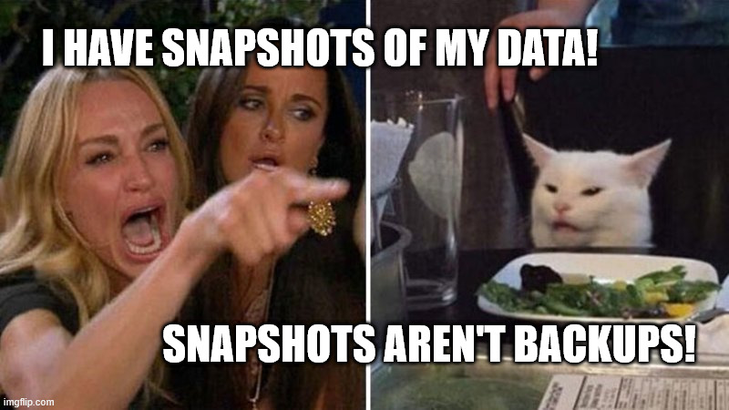
BSIDESKC 2026
TYLER JACOBS | POOLMANJIM
Notes:
When thinking about solutions remember that VM snapshots are not backups.
VM snapshots can supplement traditional backups, but they should not be the core component of the backups.
The biggest risk with VM snapshots is that there is a hardware dependency tied to the snapshot and it is usually on the same storage as the VMs themselves. If one is compromised the other is too.
Snapshots also have the issue of having dormant malware that was kept from the os during the snapshot.
-- References --
https://www.veeam.com/blog/ransomware-recovery-what-you-need-to-know.html
https://helpdesk.kaseya.com/hc/en-gb/articles/4403440684689-Important-Notice-August-4th-2021
https://www.semperis.com/blog/hypervisor-dc-snapshots-are-no-substitute-for-proper-active-directory-backups/
https://www.veeam.com/blog/why-snapshots-alone-are-not-backups.html
https://www.veeam.com/blog/backing-up-domain-controller-best-practices-for-ad-protection.html
https://www.semperis.com/active-directory-forest-recovery/
https://www.semperis.com/semperis-faq/

Slide 20
BONUS
BONUS - TESTING BACKUPS GUIDANCE
Principals
Successful backups can still have issues
Testing is critical - Especially if you only have a manual recovery process.
Keep track of tombstone lifetime.
Test Environment
ALWAYS restore to an isolated test/lab environment
Restore copies of functioning systems
Resources can be lower - except disk
Verification
Check objects/groups/etc.
Test authentication
Check system health (there will be errors)
Check database integrity (optional)
DOCUMENT YOUR TESTING AND RECOVERY PROCESS
BSIDESKC 2026
TYLER JACOBS | POOLMANJIM
Notes:
There are a lot of layers to a good backup test. I wasn’t kidding when I said this could be a talk on its own.
Why is testing important?
Backups can still have issues. Even if it shows “successful” it isn’t really successful until it is used. There can be hidden dependencies, etc.
Testing trains memory and checks for hidden dependencies - Especially with manual recoveries. The AD forest recovery guide is complex. No one can remember all the steps. Testing helps develop the memory and skills needed to actually do this life if the day comes.
Pay attention to the tombstone lifetime. This is how far back backups and be retained so it ensures you’re not invalid.
Test Environment Requirements
Always restore to a test/isolated environment. If you have two DCs on the network, it could really screw up replication and other issues. Double check this before proceeding.
Make sure you’re restoring full copies of functioning systems. Anything less isn’t valid. This is why the isolation is important.
When building the test environment CPU and Memory can be lower. Generally, disk should be the same or greater due to how backups work.
Verification of Backups
Check for objects, groups, etc. and ensure they exist as expected.
Check if you can actually authenticate to the environment using expected credentials.
Check the system/domain health. Replication will be messed up if you only restore one domain controller, that’s okay.
Run the following command to check database integrity to ensure there aren’t hidden issues.
ntdsutil "activate instance ntds" "files" "integrity" quit quit
DOCUMENT
- This process needs to be documented. This true even if using an automated solution to do the restores and backups.
-- REFERENCES --
https://www.semperis.com/blog/best-practices-active-directory-backup/
https://netwrix.com/en/resources/blog/how-to-backup-active-directory/
https://www.ninjaone.com/blog/active-directory-backup-overview-with-examples/
https://bp.veeam.com/vbr/4_Operations/O_Restores/ActiveDirectory.html

Slide 21
BONUS
BONUS - BACKUP TEST WORKFLOW
1. Encrypt Backups Before Moving
Create VHD locally.
Copy backup to VHD
BitLocker VHD
2. Create Hyper-V Setup
Private vSwitch - No internet.
Hyper-V VM should NOT be on the prod network
Can be done in Azure.
3. Copy Encrypted Backups to Hyper-V
4. Create Guests on Hyper-V
2-4 vCPU, 4GB RAM should be enough
Disk should match the backed-up server.
Attach to the Private vSwitch
Install windows (sysprep + differencing disks)
5. Restore To the Hyper-V VMs
Attach the backup disk to the VM
Boot into Windows Recovery
Restore the backup
Follow Forest Recovery Guide
BSIDESKC 2026
TYLER JACOBS | POOLMANJIM
Notes:
This is a process I’ve used to test backups before. It works well. The steps aren’t 100% comprehensive but it should be a place to start.
Here's my process.
Encrypt the backups if they're not already encrypted.
If you have an enterprise solution they **should** encrypt already.
Otherwise, create a VHD on the system with the backups using Disk Management.
Attach the VHD and copy the backups to it.
Use BitLocker to Encrypt the Drive. Store the password somewhere secure. Enable-BitLocker -MountPoint <DiskPath>
2. Create a Hyper-V Instance.
This can be on-prem or in Azure. It just needs to be isolated on the network.
Create a private switch on the Hyper-V system.
Ensure there is enough storage and resources to run 1 DC per domain and handle the restored DCs disk.
3. Upload your backup file to the Hyper-V host.
4. Create VMs on the Hyper-V host that match the disk configuration of your backups (CPU and memory can be as low as windows will tolerate).
Resources can be lower barring disk which the backup will need to be pretty close.
You can use differencing disks as long as their max size is compatible (storage overprovisioning).
Ensure the VMs are on the private vSwtich
You can create a template VM and sysprep it. Delete the VM but keep the disk. Put this disk somewhere and create differencing disks off of it which allows for saving storage and spinning up VMs much faster.
- This may slow restores some.
Configure IP information accordingly so the restored VMs can communicate with each other.
5. Restore the backups on the Hyper-V VMs.
Attach the backup disk (you will need to turn off BL)
Boot into Windows Recovery on the target VM
Restore the backup
Follow the Forest Recovery Guide
Validate

Slide 22
REAL SOLUTIONS = A PLAN
Windows Server Backup
Azure Backups
BSIDESKC 2026
TYLER JACOBS | POOLMANJIM
Notes:
Let’s talk about Windows Server Backup. It doesn’t get a lot of love. I wouldn’t even call it good. It is, however, something you already have with Windows Server. It can take backups. It can recover. And it is supported by Microsoft. Trust me. I just had an engagement about it.
WSB backups still suffer from the same issue as pretty much all major backups -- both BMR and System State still suffer from the possibly of malware dormancy.
Along with WSB, don’t forget about using nearly any off-the-shelf NAS solution or appliance to store the backups. Just make sure they support either immutable or Write-Once storage. Pretty much all the big names do this. The thing here is that the root or SYSTEM account will have right to change them so make sure that is hardened.
If you’re in the cloud running IaaS DCs, Azure Backups are another option. There is often lots of connectivity between on-prem and the cloud, so the isolation aspect is in question. There are also access issues as most Entra and Azure setups are as disorganized as AD tends to be. There is also the fact that Azure Backups restore model leaves a lot to be desired. But it is an affordable option in lieu of others.
[slide]
-- REFERENCES --
https://learn.microsoft.com/en-us/previous-versions/windows/it-pro/windows-server-2012-r2-and-2012/jj614621(v=ws.11)
https://learn.microsoft.com/en-us/troubleshoot/windows-server/backup-and-storage/backup-and-storage-overview
https://learn.microsoft.com/en-us/azure/backup/backup-overview
https://docs.azure.cn/en-us/backup/backup-overview

Slide 23
REAL SOLUTIONS = A PLAN
Windows Server Backup
Azure Backups
IFM + DSInternals
Coming Soon...
Not-So-Enterprise AD Backups
BSIDESKC 2026
TYLER JACOBS | POOLMANJIM
Notes:
IFM = Install From Media. This is a technique used to more quickly deploy domain controllers by preseeding the AD database to new domain controllers before promotion. It is really only a copy of the AD Database (NTDS.dit), the SYSVOL, and some registry items. This is a full, unencrypted copy of AD so it needs secured appropriately.
DSInternals is a toolset by a guy name Michael Grafnetter, and it is amazing. It is also detected by EDR because hackers ruin everything. This toolset does a lot but specifically I’m talking about a function where it can create a AD restore script from an IFM backup. This restore is a nothing-shared restore and will even resume the name and the machine SID, etc. Its very very neat. It’s also not fully supported and not automated for full restores.
(NOTE: Fun fact: Any enterprise tool that has a "clean os" option or similar, is likely using this behind the scenes.)
To that end I'm working on a collection scripts and stuff to smooth over the IFM + DSInternals process to create a backup solution gives some more flexibility. Keep an eye on my github for that.
-- REFERENCES --
https://learn.microsoft.com/en-us/previous-versions/windows/it-pro/windows-server-2012-r2-and-2012/cc732530(v=ws.11)
https://learn.microsoft.com/en-us/previous-versions/windows/it-pro/windows-server-2008-R2-and-2008/cc816722(v=ws.10)
https://github.com/MichaelGrafnetter/DSInternals

Slide 24
BONUS
AD IFM
What is IFM?
IFM = Installation from Media
Snapshot of the AD database that can be used to promote new domain controllers and reduce replication time by preseeding the replication data.
Creating an IFM
Pre-reqs
An existing writable DC (no RODC)
110% of the AD DB size in the %TMP% folder
Cannot be used for the first DC in a domain.
Procedure - Run the following commands from elevated command prompt.
ntdsutil activate instance ntds ifm create sysvol full C:\IFM
quit
quit
BSIDESKC 2026
TYLER JACOBS | POOLMANJIM
Notes:
IFM = Install From Media.
This is a tool in AD that creates a snapshot, or really a copy, of the AD database, SYSVOL, and some registry times that can be used to preseed the AD database to new domain controllers to speed up replication time on promotion.
Prerequisites
To build fully writable DC, you need a fully writable copy. RODCs can use either a RODC ifm or their own.
At least 100% of the NTDS.DIT size is required free in the %tmp% directory.
Cannot be used to create the first DC in a domain.
Per-domain specific.
Run the following commands from an elevated command prompt. Note, this sometimes makes EDR angry.
ntdsutil
activate instance ntds
ifm
At the IFM prompt, you can use one of the following to create different IFM types
create sysvol full C:\IFM
# writable DC with SYSVOL (recommended)
create full C:\IFM
# writable DC without SYSVOL
create sysvol rodc C:\IFM
# RODC with SYSVOL
create rodc C:\IFM
# RODC without SYSVOL
Once done, do quit twice.
quit quit
-- REFERENCES --
https://learn.microsoft.com/en-us/previous-versions/windows/it-pro/windows-server-2012-r2-and-2012/cc732530(v=ws.11)
https://learn.microsoft.com/en-us/previous-versions/windows/it-pro/windows-server-2008-R2-and-2008/cc816574(v=ws.10)
https://learn.microsoft.com/en-us/previous-versions/windows/it-pro/windows-server-2008-R2-and-2008/cc816722(v=ws.10)

Slide 25

BCDR ACTION PLAN
Get a backup solution.
Make sure the solution supports AD.
Make sure the solution can restore a full forest.
Make sure it is secured and resilient
Make sure that you’re not just using snapshots.
Backup multiple DCs
Test your backups
BSIDESKC 2026
TYLER JACOBS | POOLMANJIM
Notes:
I could talk all day about backups, but I can’t. So as a quick recap and next steps.
If you don’t have a backup solution, get one.
Make sure the solution supports AD and allows for a full forest upgrade.
Make sure the backups are secured and duplicated: 3-2-1+1 rule
Make sure that you’re not just using snapshots/checkpoints. Those aren’t backups.
Make sure you’re backing up multiple domain controllers.
Test your backups.
-- MORE BCDR RESOURCES --
https://www.hipconf.com/resources/think-you-have-an-entra-backup-think-again/

Slide 26
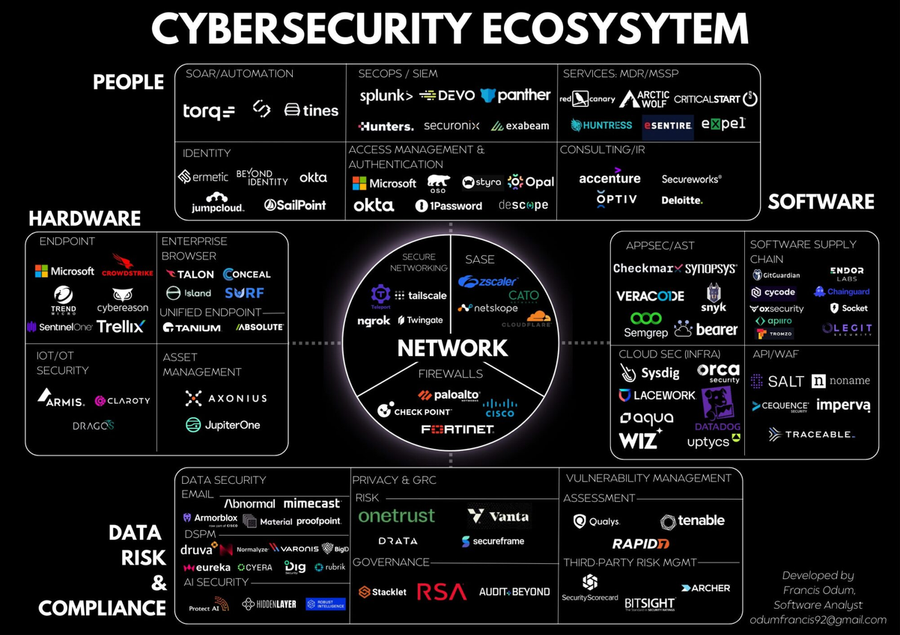
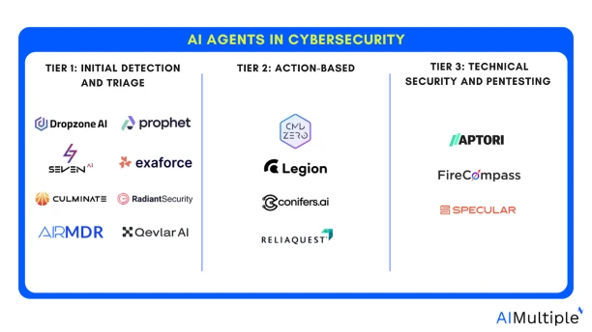
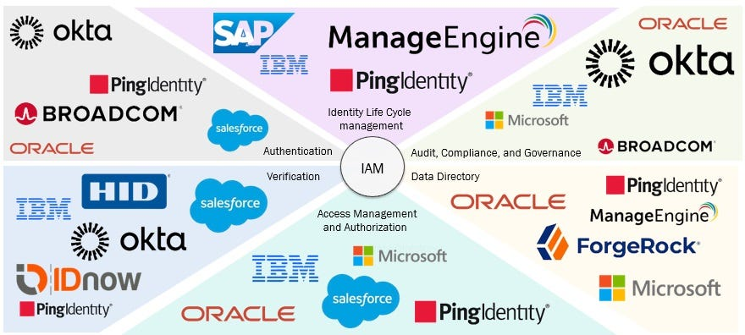
THE GHOST OF TOO MANY TOOLS
BSIDESKC 2026
TYLER JACOBS | POOLMANJIM
Notes:
I love this slide. I intentionally broke all the rules.
"Limit all the words on your slides". Nah. I'll use all the words!
There are uncountable tools for cybersecurity and identity management. I guarantee you this is not comprehensive.
Toss in the new AI tools and we have even more. It's too much for any one person to know and keep track of.
What often happens is the company buys one tool, uses half (at best) of its capabilities, and forgets about it. A few years later a new C-suite pops in and buys their tool of choice and the cycle repeats.
Don't chase shiny, new, buzzwordy solutions. Look at what is already deployed and make that work for you if it can.
The vendors don't help much. If they can they'll sell you the Nile, the Pyramids and the Sphynx's nose. It's their job. Make sure you know what you're getting into with any tools.
Also pay attention to these tool's permissions. I've seen too many of them want domain admin rights, local admin rights, or SYSTEM rights on a DC.
If the tools require those rights, let's make sure they have separate instances with separate creds or move the existing instances to be more secure. If you have an agent running SYSTEM on a DC, what can it do? EVERYTHING.
Cyber teams, your tools are cool and great but ask the question: What if my tool is the tool that gets compromised? All the analytics in the word don't make the side channel attacks against your tool non-existant.

Slide 27
PERFORMANCE / RELIABILITY MONITORING
OPERATIONAL RISK IS RISK
BSIDESKC 2026
TYLER JACOBS | POOLMANJIM
Notes:
If someone were to ask me whether I would have a killer vulnerability scanning tool or a monitoring tool for AD, I'd answer monitoring. I don't mean security monitoring either. I mean simple system performance monitoring.
Why?
Because Operational Risk is still risk!
Our responsibility as administrators are to ensure that the business services stay available and online. The moment that is not longer true, the calculus falls a part and the "value" goes away.
Vuln scanners are cool. SIEMs are necessary. Are either more important than knowing if the services we offer are healthy?
A downed system is no better than a compromised system when you talk with business leaders.
If your bank is offline, how much money is lost? If your healthcare system is down what is the cost there? Think about it.

Slide 28
PERFORMANCE / RELIABILITY MONITORING
WHAT DO YOU HAVE ALREADY?
BSIDESKC 2026
TYLER JACOBS | POOLMANJIM
Notes:
This has been mentioned before, but the first thing to consider is what tools you may already have. Are they perfect? Maybe not, but they're a hell of a lot cheaper than buying something else.
I'm also obliged to say that I'm almost 100% going to not mention the tool(s) you're thinking of here. There are some many in this space. I picked what I know. If it works, it's not stupid.
[slide]

Slide 29
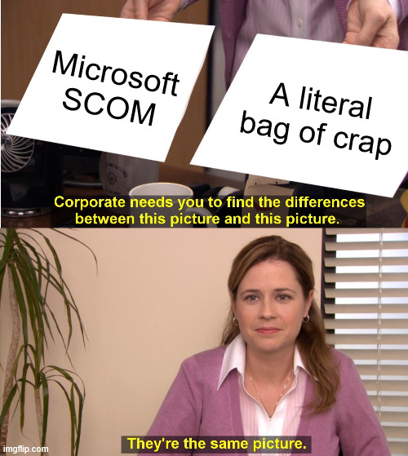
PERFORMANCE / RELIABILITY MONITORING
WHAT DO YOU HAVE ALREADY?
Systems Center Operations Manager (SCOM)
BSIDESKC 2026
TYLER JACOBS | POOLMANJIM
Notes:
Speaking of obliged tools. There is a solid chance you have SCOM. If you have the system center suite, you have SCOM.
Personally, I hate SCOM. I hate almost everything about it, but it is there for most places.
[slide]
-- REFERENCE --
kevinholman.com/2016/12/22/mp-update-totally-new-active-directory-mp-for-windows-server-2012-and-2016/
https://github.com/MicrosoftDocs/SystemCenterDocs/blob/main/SystemCenterDocs/scom/manage-ad-integration-agent-assignment.md

Slide 30
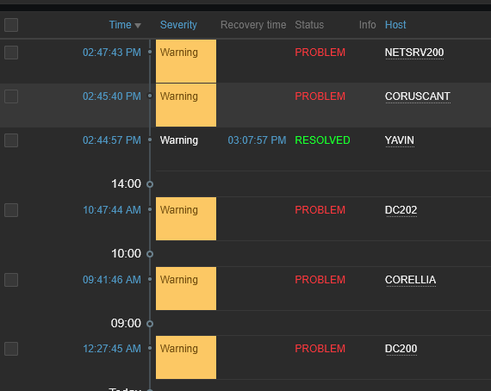
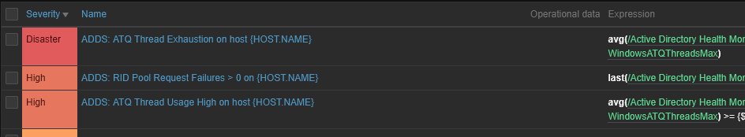
PERFORMANCE / RELIABILITY MONITORING
WHAT DO YOU HAVE ALREADY?
Systems Center Operations Manager (SCOM)
Zabbix (Free/Paid)
https://www.zabbix.com/documentation/7.0/en/manual/installation/getting_zabbix
BSIDESKC 2026
TYLER JACOBS | POOLMANJIM
Notes:
My personal favorite tool on the list is Zabbix. Sure there are others but I've used this the most in labs and it works really good.
The biggest disadvantages to Zabbix is that is a bit confusing out of the box and it doesn't have super great Windows support. They support Windows but it almost always seems like an after thought.
The good news is that I put a AD-specific template for Zabbix on my github as a starting point for anyone going down that road. I encourage you to give that a look if you're interested in Zabbix.
-- REFERENCES --
https://www.zabbix.com/manuals
https://github.com/ActiveDirectoryKC/Zabbix-AD-Health-Monitors
https://www.zabbix.com/documentation/7.0/en/manual/installation/getting_Zabbix

Slide 31
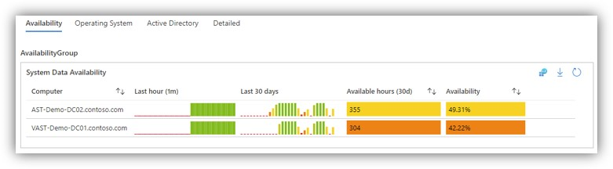
BONUS
BONUS - PERFORMANCE / RELIABILITY MONITORING
WHAT DO YOU HAVE ALREADY?
Systems Center Operations Manager (SCOM)
Azure Monitor (Paid)
https://learn.microsoft.com/en-us/azure/azure-monitor/fundamentals/overview
BSIDESKC 2026
TYLER JACOBS | POOLMANJIM
Notes:
Azure Monitor is actually a very solid tool. You can build neat dashboards that execs love but also do stuff engineers care about.
The biggest downside with Azure Monitor are that it uses Log Analytics as a data source and if you haven't used Log Analytics, they can get VERY expensive very quickly. This requires lots of attention to refine.
I suggest starting with low retention and only a few things ingested and work up.
With Azure Monitor you can find free workbooks online to help setup the dashboards and what not.
References and Resources:
https://github.com/dmrellan/Active-Directory-Performance-Assessment-with-Azure-Monitor-workbook
https://github.com/microsoft/AzureMonitorCommunity

Slide 32
BONUS
BONUS - PERFORMANCE / RELIABILITY MONITORING
WHAT DO YOU HAVE ALREADY?
Systems Center Operations Manager (SCOM)
Azure Monitor (Paid)
https://learn.microsoft.com/en-us/azure/azure-monitor/fundamentals/overview
Zabbix (Free/Paid)
https://www.zabbix.com/documentation/7.0/en/manual/installation/getting_zabbix
ELK Stack
https://www.elastic.co/elastic-stack/
BSIDESKC 2026
TYLER JACOBS | POOLMANJIM
Notes:
Slide Time: 1 minute
ELK stands for "Elastic", "LogBeat", and "Kibana".
Note: WinLogBeat is what we'd need.
The ELK stack is another tool set I've played with some. Like Zabbix Windows almost seems to be an after thought, but it has a lot of features that actually go beyond the performance and monitoring aspect.
The big thing with ELK stack is that it is cumbersome to setup. It requires a lot to get it off the ground but and it didn't like AD CS certs much (Layer 8 issue).
It is absurdly powerful and useful and has tons of features.
Resources and References:
- https://www.elastic.co/elastic-stack/

Slide 33

BONUS
BONUS - CHANGE MONITORING
Limited options
Microsoft advanced Audit Policies
Not traditional audit policies!
myADMonitor = Point in Time
Cayosoft Guardian = Trial->Free
Only 7 days of retention
BSIDESKC 2026
TYLER JACOBS | POOLMANJIM
Notes:
How do you keep track of changes in AD?
The starting point is configuring Microsoft's Advanced Audit Settings in Group Policy and rolling them out. These generate a lot of event IDs that matter.
Microsoft even has published a list of event IDs that are "signs of compromise" so that gives some filtering.
myADMonitor is a free tool that displays current AD Replication changes. It isn't intended to be run for long periods.
If you need some retention, there aren't a lot of free tools so Cayosoft Guardian would be my initial recommendation. It is a trial that evolves into a limited free version that keeps 7 days of change activity.
Resources and References
https://learn.microsoft.com/en-us/windows-server/identity/ad-ds/plan/security-best-practices/advanced-audit-policy-configuration
https://learn.microsoft.com/en-us/windows-server/identity/ad-ds/plan/security-best-practices/monitoring-active-directory-for-signs-of-compromise
https://github.com/mihemihe/myADMonitor
https://www.cayosoft.com/products/guardian/guardian-protector/

Slide 34
MONITORING ACTION PLAN
Configure AD Advanced Auditing
Group Policy \ Computer Settings \ Security Settings \ Security Options
Group Policy \ Computer Settings \ Security Settings \ Windows Settings \ Advanced Audit Policies
BSIDESKC 2026
TYLER JACOBS | POOLMANJIM
Notes:
Don’t have a tool or just something actionable?
Deploy Advanced Audit Policies. These aren’t to be confused with traditional audit policies. Advanced are better all around and the two are incompatible.
Don’t check everything. See the nodes for some places to start.
[slide]
-- REFERENCES --
https://learn.microsoft.com/en-us/windows-server/identity/ad-ds/plan/security-best-practices/advanced-audit-policy-configuration
https://learn.microsoft.com/en-us/previous-versions/windows/it-pro/windows-10/security/threat-protection/auditing/advanced-security-audit-policy-settings
https://learn.microsoft.com/en-us/windows-server/identity/ad-ds/plan/security-best-practices/monitoring-active-directory-for-signs-of-compromise

Slide 35
MONITORING ACTION PLAN
Configure AD Advanced Auditing
Group Policy \ Computer Settings \ Security Settings \ Security Options
Group Policy \ Computer Settings \ Security Settings \ Windows Settings \ Advanced Audit Policies
Configure Data Collector Sets
Perfmon \ Data Collector Sets
https://techcommunity.microsoft.com/blog/coreinfrastructureandsecurityblog/taming-perfmon-data-collector-sets/255521
BSIDESKC 2026
TYLER JACOBS | POOLMANJIM
Notes:
Data Collector Sets don't get tons of love. They are kind of clunky, but they are a good means gathering period views of the performance on a system. They can be scheduled and do get a lot of information. I recommend looking into them if you haven’t.
Personally, I find them super useful for troubleshooting (scheduled) and you can use the AD-specific Data Collector Sets as a place to start with other monitoring.
[slide]
-- REFERENCES --
https://learn.microsoft.com/en-us/dynamics365/business-central/dev-itpro/administration/monitor-work-with-data-collector-sets
https://learn.microsoft.com/en-us/previous-versions/windows/it-pro/windows-server-2008-R2-and-2008/cc749337(v=ws.11)
https://techcommunity.microsoft.com/blog/coreinfrastructureandsecurityblog/taming-perfmon-data-collector-sets/255521

Slide 36
MONITORING ACTION PLAN
Configure AD Advanced Auditing
Group Policy \ Computer Settings \ Security Settings \ Security Options
Group Policy \ Computer Settings \ Security Settings \ Windows Settings \ Advanced Audit Policies
Configure Data Collector Sets
Perfmon \ Data Collector Sets
https://techcommunity.microsoft.com/blog/coreinfrastructureandsecurityblog/taming-perfmon-data-collector-sets/255521
Get a tool (Zabbix)
My github has a template for AD
https://github.com/ActiveDirectoryKC/Zabbix-AD-Health-Monitors
BSIDESKC 2026
TYLER JACOBS | POOLMANJIM
Notes:
Get an actual monitoring/alerting tool, set it up, and configure it to alert.
My recommendation is, of course, Zabbix, but use what makes sense to you. Just make sure you're using it.
[slide]
-- REFERENCES
https://www.zabbix.com/manuals
https://github.com/ActiveDirectoryKC/Zabbix-AD-Health-Monitors
https://www.zabbix.com/documentation/7.0/en/manual/installation/getting_Zabbix

Slide 37
MONITORING ACTION PLAN
Configure AD Advanced Auditing
Group Policy \ Computer Settings \ Security Settings \ Security Options
Group Policy \ Computer Settings \ Security Settings \ Windows Settings \ Advanced Audit Policies
Configure Data Collector Sets
Perfmon \ Data Collector Sets
https://techcommunity.microsoft.com/blog/coreinfrastructureandsecurityblog/taming-perfmon-data-collector-sets/255521
Get a tool (Zabbix)
My github has a template for AD
https://github.com/ActiveDirectoryKC/Zabbix-AD-Health-Monitors
Review it the monitors / Alert
BSIDESKC 2026
TYLER JACOBS | POOLMANJIM
Notes:
None of this makes any sense if you don't use it. Make sure someone looks at the data and is assessing reliability and responding to alerts coming out of this.
You should also check to ensure you're receiving the data you expect.

Slide 38
BONUS
BONUS - AD Performance Monitoring
Procedural Guidelines
Collect performance data in 15-30 min intervals.
Lower generates too much noise.
Average / Normalize the data
Keep the highs and lows for reference.
Any raw counter (not performance counter) is just a count.
Define your thresholds.
When do you notify? Alert? Page Out?
Notable Counters
CPU, Disk, Memory Utilization
ATQ Latency (Estimated Queue Delay, Request Latency, Outstanding Queued Requests) - Keep as low as possible.
Auth issues.
DRA Pending Replication Syncs - Keep low.
Can be replication issue.
Page File % Usage and Pages / Sec - Memory issues indicator
Windows always uses the page file so it will never be 0.
Disk I/O Latency - Disk issues.
BSIDESKC 2026
TYLER JACOBS | POOLMANJIM
Notes:
When doing detailed performance monitoring with AD, the goal is to find performance bottlenecks, detect authentication stress or overload conditions, and identify replication delays. Additionally, this information can be used to augment other vulnerability and compliance monitoring by tracking insecure or deprecated tools, methods, etc.
General Procedural Guidelines
Collect data in 15-minute intervals. Do not do less.
- 1-minute intervals leads to a lot of noise. 15-minute intervals shows you more of an average over time.
- Technically you respond slower, yes, but the data is richer so you’re responding when you need to.
Attempt to average the data monthly (normalize)
- This reduces noise some and shows trends better.
Capture highs and lows too. These can show you spikes and drops which can indicate issues.
Raw counters don’t need normalized as much they just count up.
Define thresholds. When do you send notifications? Alerts? Page outs? Etc.
Metrics/Counters to Track
ATQ Estimated Queue Delay - This should be as low as possible.
ATQ Request Latency - This should be as low as possible.
ATQ Outstanding Queued Requests - As low as possible.
DRA Pending Replication Syncs - As low as possible.
Page File & Usage - Windows always uses the page file. If this starts going crazy, it could be a sign of memory issues.
Pages /sec - Same as above.
Disk I/O Latency - Can indicate the disk isn’t keep up.
LDAP Bind Time, LDAP Searches / sec, Client Sessions - These are all correlative metrics. If these spike and other stuff spikes, it can give you lots of good information.
ATQ Thread (Total, LDAP, Other) - If these exceed the maximum, auths will start queuing. Default maximum is 4x the number of CPU cores on the domain controller.
Risk Indicators
LDAP Simple Binds /sec - These are plain text password authentications. Big risks.
NTLM binds /sec - Microsoft is trying to nuke NTLM this will tell you how much is being used.
NTLM Authentications - This is a counter. Should trend downward.
Digest Authentications - This a counter. Should trend downward.

Slide 39

THE GHOST OF PERFECTION
Perfection is the enemy of good
- Voltaire
- Michael Scott
Baselines, STIGS, & Benchmarks
BSIDESKC 2026
TYLER JACOBS | POOLMANJIM
Notes:
Best practices are always a nebulous concept. Whose best practices are we using? Why do they get to decide?
The industry standard on this is baselines and benchmarks. They're co developed with the vendors with the various bodies who issue them.

Slide 40
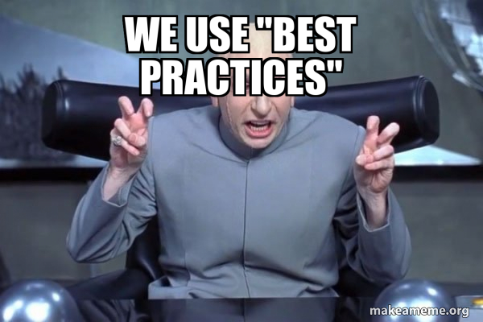
MICROSOFT SECURITY BASELINES
MICROSOFT SECURITY AND COMPLIANCE TOOLKIT
Free download from MS
https://www.microsoft.com/en-us/download/details.aspx?id=55319
Per-OS Version
Includes
GPO Templates
Policy Analyzer
Policy to Reg Key Reference
LGPO
Windows Admin Center
BSIDESKC 2026
TYLER JACOBS | POOLMANJIM
Notes:
For most places, start with the Microsoft Baselines. It's a free download and a little clunky to use, but it will help you get a good start. With the download you'll get "drop in" GPO templates and there are a couple of tools: Policy Analyzer, which can compare what you have currently versus the baseline; and LGPO which can be used to audit and edit local group policy.
There is one other thing that these include that has been a game changer for me so far. The download includes a download of a collection of excel spreadsheets that include the mappings for most Group Policy settings to their corresponding Registry Keys. This applies to most policies, but not any of the "Security Options" since those aren't registry settings. This spreadsheet is a really good resource. I even I have it pinned in excel and use it often.
The downsides to MS Security Baselines are they are Windows-only, but you're in an Active Directory hardening talk. If you were expecting Linux hardening tips see me after and tell you to ask someone else. The other disadvantage is they are somewhat limited. If you compare them to the other two I'm going to talk about, they are not as comprehensive. But remember "Perfect is the enemy of good".
Windows Admin Center supports deploying baselines from the interface.
Resources and References:
https://www.microsoft.com/en-us/download/details.aspx?id=55319
https://learn.microsoft.com/en-us/windows/security/operating-system-security/device-management/windows-security-configuration-framework/windows-security-baselines

Slide 41
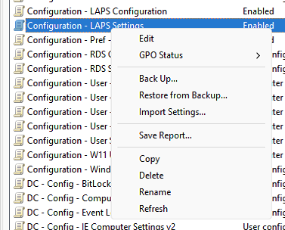
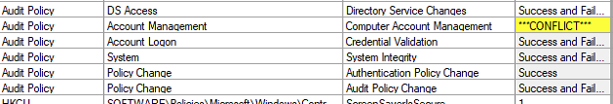
BONUS - Using Policy Analyzer
BONUS
EXPORT GROUP POLICIES
LAUNCH GROUP POILCY MANAGEMENT (GPMC)
Expand the domain.
Locate “Group Policy Objects”
Right-Click the policy \ “Back Up..”
Select a directory to store the backup.
COMPARE POLICIES WITH POLICY ANALYZER
Launch Policy Analyzer
Click “Add”
File \ Add.
Locate the GPO you exported you want to compare against.
Save a Policy Rules File in %UserProfile%\Documents\PolicyAnalyzer
Copy the policy rules included with Policy Analyzer to the above path.
Click “Reset” next to the “Policy Rule Sets in” directory.
Select the policies to compare
Click “View / Compare”
Go down the list. Differences are highlighted.
The bottom will show more information.
BSIDESKC 2026
TYLER JACOBS | POOLMANJIM
Notes:
https://learn.microsoft.com/en-us/windows/security/operating-system-security/device-management/windows-security-configuration-framework/windows-security-baselines

Slide 42

DISA STIGs
DISA = DEFENSE INFORMATION SECURITY AGENCY
STIG = SECURITY TECHNICAL IMPLEMENTATION GUIDE
US Gov. focused.
Not just Microsoft
More comprehensive than MS
Needs some tweaking
https://www.cyber.mil/stigs/
Includes
GPO Templates
SCAP Tool
Guides
BSIDESKC 2026
TYLER JACOBS | POOLMANJIM
Notes:
I could ask anyone who's used these raise their hands but this is not a game of Spot the Fed.
DISA STIGs are a type of benchmarking that is put out by the US Government for the US Government. I know that inspires tons of confidence, but give them a chance here.
The cool thing is there are STIGs for lots of different things, including lots outside of Microsoft.
For Microsoft they include drop-in GPO policy templates and even Ansible-based options.
STIGs tend to be more comprehensive than the Microsoft Baselines. My favorite thing about STIGs is the SCAP tool. This is a free download and it will do local or remote scanning of systems based on the specified STIG benchmark you included with the scan. The usual scan permissions apply, but it really can get you a good picture of the compliance.
The big downside of STIGs is that they are very, very, very much focused on the US Government, specifically the Department of Defense. If you look there are settings that really only apply to the US Government. The two I always remember are the requirement to use US Government Root CAs and to use US Government Time Servers. You can obviously ignore those specific findings and use that more as a reminder or a template for making sure you have your own secured Root CA and a known good time source.
You're all doing those things right?
I recommend using these because of the scanner and the increased coverage over MS Baselines. They're probably my favorite long term option because of how simple the SCAP tool is.
ADHD tangent: The format for the SCAP tool scans is kind of wierd. I looked at it a long time ago and decided it wasn't worth my time. I have it on good authority that you can use your LLM of choice to make your own SCAP Benchmarks.
Resources and References:
https://www.cyber.mil/stigs/
https://cyber.trackr.live/stig
SCAP Tool Download: https://www.cyber.mil/stigs/SCAP
Cyber.Trackr is a good quick viewer for STIG settings.

Slide 43
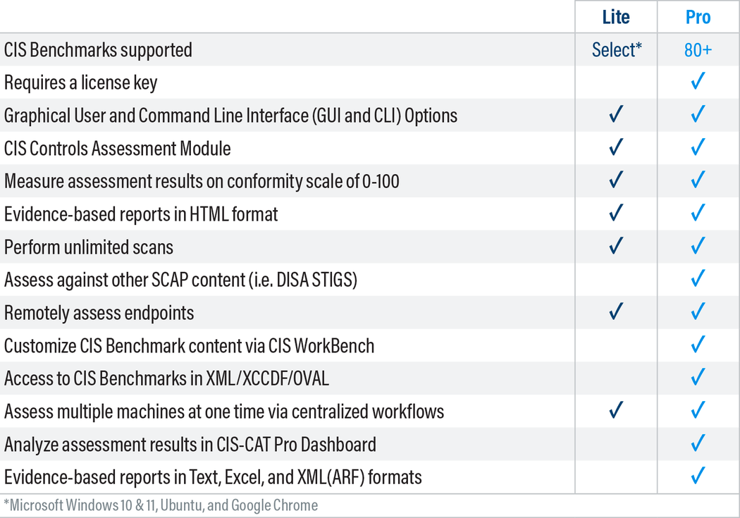
CIS BENCHMARKS
CIS = CENTER FOR INTERNET SECURITY
Like STIGs but less government
Requires email address for the guide
CIS CAT-Lite Scanner (req. email)
Limited to client OSes
Extremely comprehensive = Harder to navigate
https://downloads.cisecurity.org/#/
BSIDESKC 2026
TYLER JACOBS | POOLMANJIM
Notes:
CIS Benchmarks compare a lot to DISA STIGs. The big difference are CIS Benchmarks can go down some rabbit holes and can be super comprehensive. They are, admittedly, the ones I'm least familiar with.
They're not bad and they are more universal than DISA STIGS so there aren't any "US Government" items in them, and they offer solid guidelines for the items instead. My biggest dislike of CIS Benchmarks are that they 1) require an email to download the PDF guides and 2) they require you to pay for their scanning tool. Compliance checks depend on either their paid tool or third parties.
CIS will show up in pretty much any non-US Government compliance lists.
-- REFERENCES --
https://downloads.cisecurity.org/#/
https://learn.cisecurity.org/cis-cat-lite
https://www.huntress.com/cybersecurity-101/topic/what-are-cis-benchmarks
https://netwrix.com/en/resources/blog/cis-security-benchmarks/
Other tools with CIS Scanning
https://wazuh.com/
https://github.com/scipag/HardeningKitty

Slide 44
NOTABLE SECURITY SETTINGS
LDAP Signing -OR- LDAPS (LDAP over TLS)
https://learn.microsoft.com/en-us/windows-server/identity/manage-ldap-signing-group-policy?tabs=windows-server-2025#identify-clients-using-unsigned-ldap-binds
BSIDESKC 2026
TYLER JACOBS | POOLMANJIM
Notes:
There are literally hundreds of security settings, and it is impossible to call out all the meaningful ones here. Instead, I chose some that are either a really big deal or have a gotcha associated.
LDAP signing is one of the easier ones to get in. There are two ways to do it, you can use LDAP Signing (no CA), or you can do LDAPS which requires a CA and has broader support in my experience. Either satisfy.
There are Audit Policies for LDAP Signing auditing.
-- References
LDAP References
https://learn.microsoft.com/en-us/windows-server/identity/ad-ds/ldap-signing
https://michaelwaterman.nl/2026/01/31/building-high-available-ldaps-architectures/
https://support.microsoft.com/en-us/topic/2020-2023-and-2024-ldap-channel-binding-and-ldap-signing-requirements-for-windows-kb4520412-ef185fb8-00f7-167d-744c-f299a66fc00a
https://learn.microsoft.com/en-us/windows-server/identity/ad-ds/ldap-client-performance-counters
learn.microsoft.com/en-us/windows-server/identity/ad-ds/configure-ldap-signing-certificates?tabs=microsoft-enterprise-ca
https://learn.microsoft.com/en-us/windows-server/identity/manage-ldap-signing-group-policy?tabs=windows-server-2025
https://support.microsoft.com/en-us/topic/kb4034879-use-the-ldapenforcechannelbinding-registry-entry-to-make-ldap-authentication-over-ssl-tls-more-secure-e9ecfa27-5e57-8519-6ba3-d2c06b21812e
SMB
- https://learn.microsoft.com/en-us/windows-server/storage/file-server/smb-signing-overview
NTLM
- https://syfuhs.net/deprecating-ntlm-is-easy-and-other-lies-we-tell-ourselves
- https://techcommunity.microsoft.com/blog/windows-itpro-blog/advancing-windows-security-disabling-ntlm-by-default/4489526
- https://support.microsoft.com/en-us/topic/overview-of-ntlm-auditing-enhancements-in-windows-11-version-24h2-and-windows-server-2025-b7ead732-6fc5-46a3-a943-27a4571d9e7b
- https://support.microsoft.com/en-us/topic/upcoming-changes-to-ntlmv1-in-windows-11-version-24h2-and-windows-server-2025-c0554217-cdbc-420f-b47c-e02b2db49b2e
Kerberos Delegation
- https://learn.microsoft.com/en-us/windows-server/security/kerberos/kerberos-constrained-delegation-overview
- https://learn.microsoft.com/en-us/archive/blogs/poshchap/security-focus-analysing-account-is-sensitive-and-cannot-be-delegated-for-privileged-accounts
- https://learn.microsoft.com/en-us/previous-versions/tn-archive/cc995228(v=technet.10)?redirectedfrom=MSDN
- https://syfuhs.net/understanding-identity-delegation
Kerberos Encryption
- https://syfuhs.net/lessons-in-disabling-rc4-in-active-directory
- https://www.microsoft.com/en-us/windows-server/blog/2025/12/03/beyond-rc4-for-windows-authentication/
- https://support.microsoft.com/en-us/topic/how-to-manage-kerberos-kdc-usage-of-rc4-for-service-account-ticket-issuance-changes-related-to-cve-2026-20833-1ebcda33-720a-4da8-93c1-b0496e1910dc
ros-kdc-usage-of-rc4-for-service-account-ticket-issuance-changes-related-to-cve-2026-20833-1ebcda33-720a-4da8-93c1-b0496e1910dc

Slide 45
NOTABLE SECURITY SETTINGS
LDAP Signing
https://learn.microsoft.com/en-us/windows-server/identity/manage-ldap-signing-group-policy?tabs=windows-server-2025#identify-clients-using-unsigned-ldap-binds
SMB Signing
https://learn.microsoft.com/en-us/windows-server/storage/file-server/smb-signing-overview
BSIDESKC 2026
TYLER JACOBS | POOLMANJIM
Notes:
SMB Signing
- This is an easy one to get enabled and protects against several attacks. I've not seen much stuff have issues with it these days.
-- References
LDAP References
- https://learn.microsoft.com/en-us/windows-server/identity/ad-ds/ldap-signing
- https://support.microsoft.com/en-us/topic/2020-2023-and-2024-ldap-channel-binding-and-ldap-signing-requirements-for-windows-kb4520412-ef185fb8-00f7-167d-744c-f299a66fc00a
-https://learn.microsoft.com/en-us/windows-server/identity/ad-ds/ldap-client-performance-counters
- learn.microsoft.com/en-us/windows-server/identity/ad-ds/configure-ldap-signing-certificates?tabs=microsoft-enterprise-ca
- https://learn.microsoft.com/en-us/windows-server/identity/manage-ldap-signing-group-policy?tabs=windows-server-2025
- https://support.microsoft.com/en-us/topic/kb4034879-use-the-ldapenforcechannelbinding-registry-entry-to-make-ldap-authentication-over-ssl-tls-more-secure-e9ecfa27-5e57-8519-6ba3-d2c06b21812e
SMB
- https://learn.microsoft.com/en-us/windows-server/storage/file-server/smb-signing-overview
NTLM
- https://syfuhs.net/deprecating-ntlm-is-easy-and-other-lies-we-tell-ourselves
- https://techcommunity.microsoft.com/blog/windows-itpro-blog/advancing-windows-security-disabling-ntlm-by-default/4489526
- https://support.microsoft.com/en-us/topic/overview-of-ntlm-auditing-enhancements-in-windows-11-version-24h2-and-windows-server-2025-b7ead732-6fc5-46a3-a943-27a4571d9e7b
- https://support.microsoft.com/en-us/topic/upcoming-changes-to-ntlmv1-in-windows-11-version-24h2-and-windows-server-2025-c0554217-cdbc-420f-b47c-e02b2db49b2e
Kerberos Delegation
- https://learn.microsoft.com/en-us/windows-server/security/kerberos/kerberos-constrained-delegation-overview
- https://learn.microsoft.com/en-us/archive/blogs/poshchap/security-focus-analysing-account-is-sensitive-and-cannot-be-delegated-for-privileged-accounts
- https://learn.microsoft.com/en-us/previous-versions/tn-archive/cc995228(v=technet.10)?redirectedfrom=MSDN
- https://syfuhs.net/understanding-identity-delegation
Kerberos Encryption
- https://syfuhs.net/lessons-in-disabling-rc4-in-active-directory
- https://www.microsoft.com/en-us/windows-server/blog/2025/12/03/beyond-rc4-for-windows-authentication/
- https://support.microsoft.com/en-us/topic/how-to-manage-kerberos-kdc-usage-of-rc4-for-service-account-ticket-issuance-changes-related-to-cve-2026-20833-1ebcda33-720a-4da8-93c1-b0496e1910dc

Slide 46
NOTABLE SECURITY SETTINGS
LDAP Signing
https://learn.microsoft.com/en-us/windows-server/identity/manage-ldap-signing-group-policy?tabs=windows-server-2025#identify-clients-using-unsigned-ldap-binds
SMB Signing
https://learn.microsoft.com/en-us/windows-server/storage/file-server/smb-signing-overview
NTLM Hardening
NTLMv1 blocking forced enforcement Oct 2026 (W11 + Server 2025)
Auditing: GPMC \ Computer Settings \ Admin. Templates \ System \ NTLM \ NTLM Enhanced Logging
BSIDESKC 2026
TYLER JACOBS | POOLMANJIM
Notes:
NTLM Hardening
- This covers the Microsoft push to end NTLM.
- There are two types of NTLM: v1 and v2. v1 needs to die in fire so if you're using it, get rid of it.
- v2 is old and needs to go, but it is still needed by a lot of apps.
- There are audit policies to nail these down.
-- References
LDAP References
- https://learn.microsoft.com/en-us/windows-server/identity/ad-ds/ldap-signing
- https://support.microsoft.com/en-us/topic/2020-2023-and-2024-ldap-channel-binding-and-ldap-signing-requirements-for-windows-kb4520412-ef185fb8-00f7-167d-744c-f299a66fc00a
-https://learn.microsoft.com/en-us/windows-server/identity/ad-ds/ldap-client-performance-counters
- learn.microsoft.com/en-us/windows-server/identity/ad-ds/configure-ldap-signing-certificates?tabs=microsoft-enterprise-ca
- https://learn.microsoft.com/en-us/windows-server/identity/manage-ldap-signing-group-policy?tabs=windows-server-2025
- https://support.microsoft.com/en-us/topic/kb4034879-use-the-ldapenforcechannelbinding-registry-entry-to-make-ldap-authentication-over-ssl-tls-more-secure-e9ecfa27-5e57-8519-6ba3-d2c06b21812e
SMB
- https://learn.microsoft.com/en-us/windows-server/storage/file-server/smb-signing-overview
NTLM
- https://syfuhs.net/deprecating-ntlm-is-easy-and-other-lies-we-tell-ourselves
- https://techcommunity.microsoft.com/blog/windows-itpro-blog/advancing-windows-security-disabling-ntlm-by-default/4489526
- https://support.microsoft.com/en-us/topic/overview-of-ntlm-auditing-enhancements-in-windows-11-version-24h2-and-windows-server-2025-b7ead732-6fc5-46a3-a943-27a4571d9e7b
- https://support.microsoft.com/en-us/topic/upcoming-changes-to-ntlmv1-in-windows-11-version-24h2-and-windows-server-2025-c0554217-cdbc-420f-b47c-e02b2db49b2e
Kerberos Delegation
- https://learn.microsoft.com/en-us/windows-server/security/kerberos/kerberos-constrained-delegation-overview
- https://learn.microsoft.com/en-us/archive/blogs/poshchap/security-focus-analysing-account-is-sensitive-and-cannot-be-delegated-for-privileged-accounts
- https://learn.microsoft.com/en-us/previous-versions/tn-archive/cc995228(v=technet.10)?redirectedfrom=MSDN
- https://syfuhs.net/understanding-identity-delegation
Kerberos Encryption
- https://syfuhs.net/lessons-in-disabling-rc4-in-active-directory
- https://www.microsoft.com/en-us/windows-server/blog/2025/12/03/beyond-rc4-for-windows-authentication/
- https://support.microsoft.com/en-us/topic/how-to-manage-kerberos-kdc-usage-of-rc4-for-service-account-ticket-issuance-changes-related-to-cve-2026-20833-1ebcda33-720a-4da8-93c1-b0496e1910dc

Slide 47
NOTABLE SECURITY SETTINGS
LDAP Signing
https://learn.microsoft.com/en-us/windows-server/identity/manage-ldap-signing-group-policy?tabs=windows-server-2025#identify-clients-using-unsigned-ldap-binds
Kerberos Encryption Types
Get-ADUser -Filter "'msDS-SupportedEncryptionTypes' -band 0x4 -or 'msDS-SupportedEncryptionTypes' -band 0x1 -or 'msDS-SupportedEncryptionTypes' -band 0x2" -Properties msDS-SupportedEncryptionTypes
SMB Signing
https://learn.microsoft.com/en-us/windows-server/storage/file-server/smb-signing-overview
NTLM Hardening
NTLMv1 blocking forced enforcement Oct 2026
Auditing: GPMC \ Computer Settings \ Admin. Templates \ System \ NTLM \ NTLM Enhanced Logging
BSIDESKC 2026
TYLER JACOBS | POOLMANJIM
Notes:
Kerberos Encryption Types
- Microsoft has gone to town on these lately with the demise of RC4. If you're still using it, get off it.
- At a minimum start finding RC4 stuff and rooting it out and make sure AES is enabled wherever possible.
-- References
LDAP References
- https://learn.microsoft.com/en-us/windows-server/identity/ad-ds/ldap-signing
- https://support.microsoft.com/en-us/topic/2020-2023-and-2024-ldap-channel-binding-and-ldap-signing-requirements-for-windows-kb4520412-ef185fb8-00f7-167d-744c-f299a66fc00a
-https://learn.microsoft.com/en-us/windows-server/identity/ad-ds/ldap-client-performance-counters
- learn.microsoft.com/en-us/windows-server/identity/ad-ds/configure-ldap-signing-certificates?tabs=microsoft-enterprise-ca
- https://learn.microsoft.com/en-us/windows-server/identity/manage-ldap-signing-group-policy?tabs=windows-server-2025
- https://support.microsoft.com/en-us/topic/kb4034879-use-the-ldapenforcechannelbinding-registry-entry-to-make-ldap-authentication-over-ssl-tls-more-secure-e9ecfa27-5e57-8519-6ba3-d2c06b21812e
SMB
- https://learn.microsoft.com/en-us/windows-server/storage/file-server/smb-signing-overview
NTLM
- https://syfuhs.net/deprecating-ntlm-is-easy-and-other-lies-we-tell-ourselves
- https://techcommunity.microsoft.com/blog/windows-itpro-blog/advancing-windows-security-disabling-ntlm-by-default/4489526
- https://support.microsoft.com/en-us/topic/overview-of-ntlm-auditing-enhancements-in-windows-11-version-24h2-and-windows-server-2025-b7ead732-6fc5-46a3-a943-27a4571d9e7b
- https://support.microsoft.com/en-us/topic/upcoming-changes-to-ntlmv1-in-windows-11-version-24h2-and-windows-server-2025-c0554217-cdbc-420f-b47c-e02b2db49b2e
Kerberos Delegation
- https://learn.microsoft.com/en-us/windows-server/security/kerberos/kerberos-constrained-delegation-overview
- https://learn.microsoft.com/en-us/archive/blogs/poshchap/security-focus-analysing-account-is-sensitive-and-cannot-be-delegated-for-privileged-accounts
- https://learn.microsoft.com/en-us/previous-versions/tn-archive/cc995228(v=technet.10)?redirectedfrom=MSDN
- https://syfuhs.net/understanding-identity-delegation
Kerberos Encryption
- https://syfuhs.net/lessons-in-disabling-rc4-in-active-directory
- https://www.microsoft.com/en-us/windows-server/blog/2025/12/03/beyond-rc4-for-windows-authentication/
- https://support.microsoft.com/en-us/topic/how-to-manage-kerberos-kdc-usage-of-rc4-for-service-account-ticket-issuance-changes-related-to-cve-2026-20833-1ebcda33-720a-4da8-93c1-b0496e1910dc
et-issuance-changes-related-to-cve-2026-20833-1ebcda33-720a-4da8-93c1-b0496e1910dc

Slide 48
NOTABLE SECURITY SETTINGS
LDAP Signing
https://learn.microsoft.com/en-us/windows-server/identity/manage-ldap-signing-group-policy?tabs=windows-server-2025#identify-clients-using-unsigned-ldap-binds
Kerberos Encryption Types
Get-ADUser -Filter "'msDS-SupportedEncryptionTypes' -band 0x4 -or 'msDS-SupportedEncryptionTypes' -band 0x1 -or 'msDS-SupportedEncryptionTypes' -band 0x2" -Properties msDS-SupportedEncryptionTypes
SMB Signing
https://learn.microsoft.com/en-us/windows-server/storage/file-server/smb-signing-overview
Kerberos Delegations
Get-ADComputer -Filter "'TrustedForDelegation' -eq $true -or 'TrustedToAuthenticateForDelegation' -eq $true"
NTLM Hardening
NTLMv1 blocking forced enforcement Oct 2026
Auditing: GPMC \ Computer Settings \ Admin. Templates \ System \ NTLM \ NTLM Enhanced Logging
BSIDESKC 2026
TYLER JACOBS | POOLMANJIM
Notes:
Kerberos Delegations
- Kerberos Delegation is impersonation and it by itself isn't bad, but has options that are horrifying.
- Basically, find anything running unconstrained delegation or protocol translation.
-- References
LDAP References
- https://learn.microsoft.com/en-us/windows-server/identity/ad-ds/ldap-signing
- https://support.microsoft.com/en-us/topic/2020-2023-and-2024-ldap-channel-binding-and-ldap-signing-requirements-for-windows-kb4520412-ef185fb8-00f7-167d-744c-f299a66fc00a
-https://learn.microsoft.com/en-us/windows-server/identity/ad-ds/ldap-client-performance-counters
- learn.microsoft.com/en-us/windows-server/identity/ad-ds/configure-ldap-signing-certificates?tabs=microsoft-enterprise-ca
- https://learn.microsoft.com/en-us/windows-server/identity/manage-ldap-signing-group-policy?tabs=windows-server-2025
- https://support.microsoft.com/en-us/topic/kb4034879-use-the-ldapenforcechannelbinding-registry-entry-to-make-ldap-authentication-over-ssl-tls-more-secure-e9ecfa27-5e57-8519-6ba3-d2c06b21812e
SMB
- https://learn.microsoft.com/en-us/windows-server/storage/file-server/smb-signing-overview
NTLM
- https://syfuhs.net/deprecating-ntlm-is-easy-and-other-lies-we-tell-ourselves
- https://techcommunity.microsoft.com/blog/windows-itpro-blog/advancing-windows-security-disabling-ntlm-by-default/4489526
- https://support.microsoft.com/en-us/topic/overview-of-ntlm-auditing-enhancements-in-windows-11-version-24h2-and-windows-server-2025-b7ead732-6fc5-46a3-a943-27a4571d9e7b
- https://support.microsoft.com/en-us/topic/upcoming-changes-to-ntlmv1-in-windows-11-version-24h2-and-windows-server-2025-c0554217-cdbc-420f-b47c-e02b2db49b2e
Kerberos Delegation
- https://learn.microsoft.com/en-us/windows-server/security/kerberos/kerberos-constrained-delegation-overview
- https://learn.microsoft.com/en-us/archive/blogs/poshchap/security-focus-analysing-account-is-sensitive-and-cannot-be-delegated-for-privileged-accounts
- https://learn.microsoft.com/en-us/previous-versions/tn-archive/cc995228(v=technet.10)?redirectedfrom=MSDN
- https://syfuhs.net/understanding-identity-delegation
Kerberos Encryption
- https://syfuhs.net/lessons-in-disabling-rc4-in-active-directory
- https://www.microsoft.com/en-us/windows-server/blog/2025/12/03/beyond-rc4-for-windows-authentication/
- https://support.microsoft.com/en-us/topic/how-to-manage-kerberos-kdc-usage-of-rc4-for-service-account-ticket-issuance-changes-related-to-cve-2026-20833-1ebcda33-720a-4da8-93c1-b0496e1910dc
s-kdc-usage-of-rc4-for-service-account-ticket-issuance-changes-related-to-cve-2026-20833-1ebcda33-720a-4da8-93c1-b0496e1910dc

Slide 49
BONUS
NOTABLE SECURITY SETTINGS
LDAP Signing
https://learn.microsoft.com/en-us/windows-server/identity/manage-ldap-signing-group-policy?tabs=windows-server-2025#identify-clients-using-unsigned-ldap-binds
Kerberos Encryption Types
Get-ADUser -Filter "'msDS-SupportedEncryptionTypes' -band 0x4 -or 'msDS-SupportedEncryptionTypes' -band 0x1 -or 'msDS-SupportedEncryptionTypes' -band 0x2" -Properties msDS-SupportedEncryptionTypes
SMB Signing
https://learn.microsoft.com/en-us/windows-server/storage/file-server/smb-signing-overview
NTLM Hardening
NTLMv1 blocking forced enforcement Oct 2026
Auditing: GPMC \ Computer Settings \ Admin. Templates \ System \ NTLM \ NTLM Enhanced Logging
LDAP Channel Binding
Reg Add HKEY_LOCAL_MACHINE\SYSTEM\CurrentControlSet\Services\NTDS\Diagnostics /v "16 LDAP Interface Events" /t REG_DWORD /d 2
BSIDESKC 2026
BSIDESKC 2026
TYLER JACOBS | POOLMANJIM
TYLER JACOBS | POOLMANJIM
Notes:
LDAP Channel Binding is useful as it prevents some MITM attacks. The challenge here is poorly supported by older OSes, particularly older Linux.
For both of these there are audit policies, configure those.
(References below)
-- References
LDAP References
- https://learn.microsoft.com/en-us/windows-server/identity/ad-ds/ldap-signing
- https://support.microsoft.com/en-us/topic/2020-2023-and-2024-ldap-channel-binding-and-ldap-signing-requirements-for-windows-kb4520412-ef185fb8-00f7-167d-744c-f299a66fc00a
-https://learn.microsoft.com/en-us/windows-server/identity/ad-ds/ldap-client-performance-counters
- learn.microsoft.com/en-us/windows-server/identity/ad-ds/configure-ldap-signing-certificates?tabs=microsoft-enterprise-ca
- https://learn.microsoft.com/en-us/windows-server/identity/manage-ldap-signing-group-policy?tabs=windows-server-2025
- https://support.microsoft.com/en-us/topic/kb4034879-use-the-ldapenforcechannelbinding-registry-entry-to-make-ldap-authentication-over-ssl-tls-more-secure-e9ecfa27-5e57-8519-6ba3-d2c06b21812e
SMB
- https://learn.microsoft.com/en-us/windows-server/storage/file-server/smb-signing-overview
NTLM
- https://syfuhs.net/deprecating-ntlm-is-easy-and-other-lies-we-tell-ourselves
- https://techcommunity.microsoft.com/blog/windows-itpro-blog/advancing-windows-security-disabling-ntlm-by-default/4489526
- https://support.microsoft.com/en-us/topic/overview-of-ntlm-auditing-enhancements-in-windows-11-version-24h2-and-windows-server-2025-b7ead732-6fc5-46a3-a943-27a4571d9e7b
- https://support.microsoft.com/en-us/topic/upcoming-changes-to-ntlmv1-in-windows-11-version-24h2-and-windows-server-2025-c0554217-cdbc-420f-b47c-e02b2db49b2e
Kerberos Delegation
- https://learn.microsoft.com/en-us/windows-server/security/kerberos/kerberos-constrained-delegation-overview
- https://learn.microsoft.com/en-us/archive/blogs/poshchap/security-focus-analysing-account-is-sensitive-and-cannot-be-delegated-for-privileged-accounts
- https://learn.microsoft.com/en-us/previous-versions/tn-archive/cc995228(v=technet.10)?redirectedfrom=MSDN
- https://syfuhs.net/understanding-identity-delegation
Kerberos Encryption
- https://syfuhs.net/lessons-in-disabling-rc4-in-active-directory
- https://www.microsoft.com/en-us/windows-server/blog/2025/12/03/beyond-rc4-for-windows-authentication/
- https://support.microsoft.com/en-us/topic/how-to-manage-kerberos-kdc-usage-of-rc4-for-service-account-ticket-issuance-changes-related-to-cve-2026-20833-1ebcda33-720a-4da8-93c1-b0496e1910dc

Slide 50
BASELINES IMPLEMENTATION - WHERE TO START?
Start with MS Security Baselines
Sort Settings by Impact vs. Risk
Deploy to Non-Critical Servers First
Coordinate with Depts. for Deployment
Review STIGs/CIS Benchmarks
BSIDESKC 2026
TYLER JACOBS | POOLMANJIM
Notes:
If you don't know where to start, start with MS Baselines. They're fast, their simple.
Regardless of where you start, review the settings and get a rough idea of compliance. If you're looking at STIGs or CIS Benchmarks they're categorized by severity. I recommend reviewing the missing configurations or items and splitting them into three groups: high-impact, moderate-impact, and low-impact. Impact here isn't security risk -- impact is how likely am I to cause an a resume generating event by doing this? I have a list in the slide notes that you can look at later where I make an attempt to do some of this categorization for you, so I encourage you to look at that. Just be careful, what I think is low impact may not be low impact in your environment.
Get projects started and approvals moving for the bigger items and start knocking out the low-impact items. They will move your bar forward and while the gains won't be great, they are a start. Once those start moving you can start focusing on the larger items.
Another thing I tend to do is compare the settings from a couple of the different benchmarks and choose the stricter of the two when they differ. This is particularly useful for audit settings as they vary a lot between the different baselines.
Don't get overwhelmed. From there work through the findings systematically. Anything you can implement easily without taking on too much business risk, do it. Everything else get plans and projects in place to start resolving them over time. If your security team is pushing for things, that helps prioritize.

Slide 51
THE GHOST OF WEAK PASSWORDS
Password Controls
BSIDESKC 2026
TYLER JACOBS | POOLMANJIM
Notes:
A few years ago, NIST completely overhauled the guidance on passwords and password policies.
One of the challenges I noticed, most solutions to NIST's requirements involve a cost.
-- REFERECES --
https://pages.nist.gov/800-63-3/sp800-63b.html

Slide 52
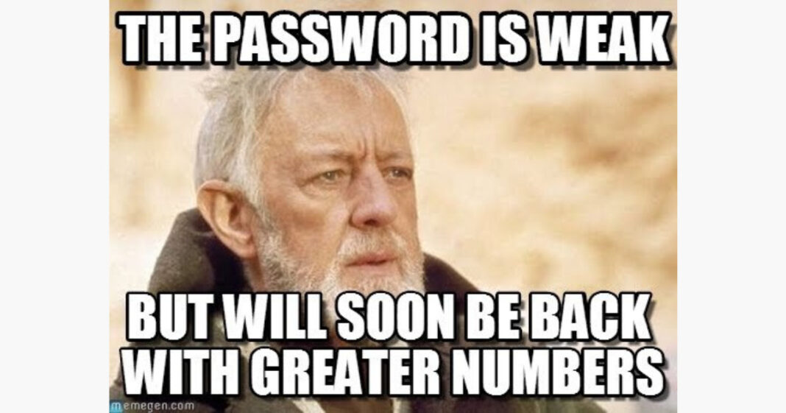
NIST SPECIAL PUBLICATION 800-63B
Password Length > Complexity
Bad Password Lists
(credential screening)
Passwordless = Win
Forced Expiration = Not Win
https://pages.nist.gov/800-63-3/sp800-63b.html
BSIDESKC 2026
TYLER JACOBS | POOLMANJIM
Notes:
Here are NISTs 800-63B controls.
1. Password Length is better than password complexity.
2. Use bad password lists to prevent use of known compromised passwords.
3. Deploy passwordless solutions wherever possible.
4. Do not employ forced expiration of passwords at an interval. Only force resets on known compromised accounts.
While I don't 100% agree with all these, there is a lot of good information here. What could go wrong?
-- REFERECES --
https://pages.nist.gov/800-63-3/sp800-63b.html

Slide 53
BAD PASSWORD LISTS
Microsoft has had them forever
Password Filters
https://learn.microsoft.com/en-us/windows/win32/secmgmt/password-filters
BSIDESKC 2026
TYLER JACOBS | POOLMANJIM
Notes:
Bad Password lists (also called Password Filters in AD) have been in AD for a long time. They pre-date Azure.
Based on how the filter's design they can just be simple keyword matches, there are also wildcards, and all kinds of options built into them. They're pretty slick.
All the different filter types behave more or less the same. You can have lists of known bad passwords (haveibeenpwned) and you can create certain customization to match your needs.
[slide]
-- REFERENCES --
Password Filters
https://learn.microsoft.com/en-us/windows/win32/secmgmt/password-filters
Entra Password Protection
https://learn.microsoft.com/en-us/entra/identity/authentication/concept-password-ban-bad
3rd Party Tools:
Litnet Password Protection - https://github.com/lithnet/ad-password-protection
PassFiltEx - github.com/ryanries/PassFiltEx

Slide 54
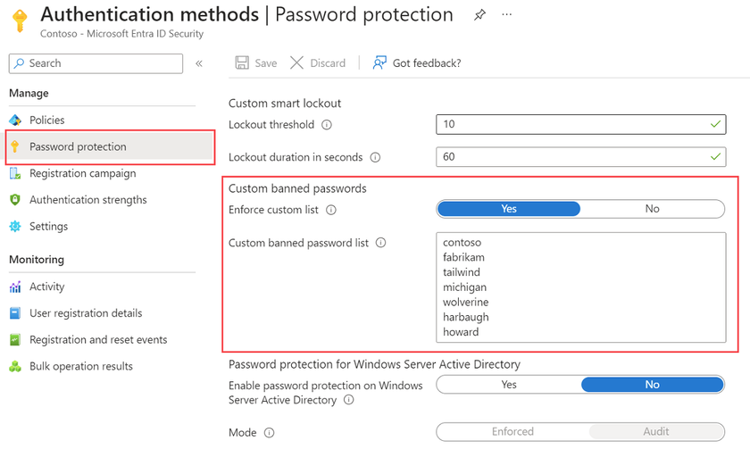
BAD PASSWORD LISTS
Microsoft has had them forever
Password Filters
https://learn.microsoft.com/en-us/windows/win32/secmgmt/password-filters
Entra Password Protection (EPP)
Cloud Solution + Not Free
Formerly Azure Password Protection (APP)
https://learn.microsoft.com/en-us/entra/identity/authentication/concept-password-ban-bad
BSIDESKC 2026
TYLER JACOBS | POOLMANJIM
Notes:
Entra Password Protection is more or less the industry standard. I fully suspect in two weeks it will be called something like Defender Copilot for Password or some absolute nonsense.
EPP is great. It is easy to setup and does pretty much what you want it to do. It does require P1 or P2 licenses, or one of the Es but beyond that it is just a proxy server that lives on prem that syncs the password lists from the cloud. AD checks the proxy and you get filtering.
-- REFERENCES --
Password Filters
https://learn.microsoft.com/en-us/windows/win32/secmgmt/password-filters
Entra Password Protection
https://learn.microsoft.com/en-us/entra/identity/authentication/concept-password-ban-bad
3rd Party Tools:
Litnet Password Protection - https://github.com/lithnet/ad-password-protection
PassFiltEx - github.com/ryanries/PassFiltEx

Slide 55
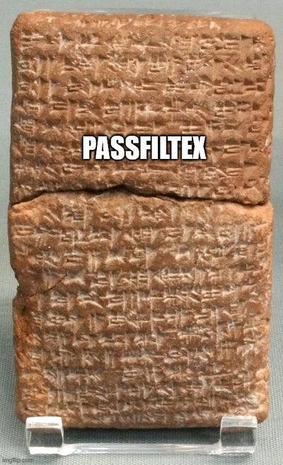
BAD PASSWORD LISTS
Microsoft has had them forever
Password Filters
https://learn.microsoft.com/en-us/windows/win32/secmgmt/password-filters
Entra Password Protection (EPP)
Cloud Solution + Not Free
Formerly Azure Password Protection (APP)
https://learn.microsoft.com/en-us/entra/identity/authentication/concept-password-ban-bad
Open Source / Freemium
Lithnet Password Protection (freemium)
https://github.com/lithnet/ad-password-protection
PassFiltEx (FOSS + Expertise)
github.com/ryanries/PassFiltEx
BSIDESKC 2026
TYLER JACOBS | POOLMANJIM
Notes:
Lithent Password Protection is free. And Open Source. It's less glamorous than EPP but it works. Install it. Run a command to add HaveIBeenPwed and your set.
I'll mention them more later.
This last one is our honorable mention. It is a password filter written by Ryan Ries who is a legend at Microsoft. He wrote this tool ages ago, it works. I should be clear it is NOT an official Microsoft product. He even did some major updates a couple years ago. It's even less polished than Lithnet.
-- REFERENCES --
Password Filters
https://learn.microsoft.com/en-us/windows/win32/secmgmt/password-filters
Entra Password Protection
https://learn.microsoft.com/en-us/entra/identity/authentication/concept-password-ban-bad
3rd Party Tools:
Litnet Password Protection - https://github.com/lithnet/ad-password-protection
PassFiltEx - github.com/ryanries/PassFiltEx

Slide 56

BONUS - Can I have multiple filters?
BONUS
CAN I HAVE MULTIPLE PASSWORD FILTERS?
Yes. But.. Don’t.
BSIDESKC 2026
TYLER JACOBS | POOLMANJIM
Notes:
Slide Time: 1 min
The simple answer is yes. I've tested it. The process in order as they are applied to LSASS.
The less-than-simple answer is... Don't. If you play stupid games you win stupid prizes.
-- REFERENCES --
Password Filters
https://learn.microsoft.com/en-us/windows/win32/secmgmt/password-filters
Entra Password Protection
https://learn.microsoft.com/en-us/entra/identity/authentication/concept-password-ban-bad
3rd Party Tools:
Litnet Password Protection - https://github.com/lithnet/ad-password-protection
PassFiltEx - github.com/ryanries/PassFiltEx

Slide 57

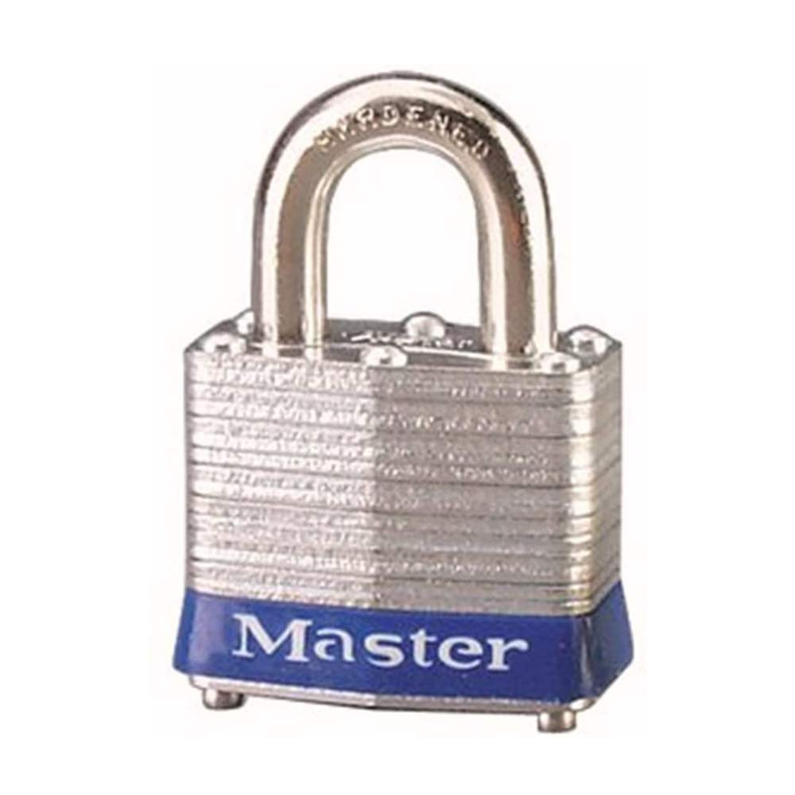
FACT
PASSKEYS / MFA
Many on-prem MFA solutions are theater
MFA is great
MS says don’t sync privileged accounts
OPTIONS?
Duo Free Tier - 5 Accounts
Entra MFA*
Cert-based Auth
Smart Cards + PKI
SECURITY THEATRE
BSIDESKC 2026
TYLER JACOBS | POOLMANJIM
Notes:
MFA in many of it's on-prem implementations is really security theatre.
[slide]
I don't hate MFA. It's great if it is done correctly.
AD doesn't have any native MFA options on-prem. You have to go with a third party and they usually either function one of two ways and pass-keys currently really depend on a client or cloud.
It also isn't recommended by MS to sync privileged accounts.
1. They just secure RDP which, I'm sure all the Pentesters in the room will tell me is 100% the only way to breach an environment.
2. They require kernel-level process hooks which introduces some severe instability to Windows so you introduce operation risk.
Auditors like their tools and insurance has to check boxes so we may have to have something.
- Pass keys don't fit due to the no sync issue and costs limitations.
- Duo supports some trial accounts with limited features. This only protects the front door (RDP) and leaves other areas exposed.
- Entra MFA (for cloud solutions) since super privilege accounts shouldn't be synced, this is limited. There are some options in my notes.
- WHfB is good and is passwordless, but requires syncing or ADFS so there is a limit there too.
- Cert-based Auth. This is MFA without the traditional push notification and "enter the number". This is just certificate-based auth. Problem here is the PKI side of it, hardware tokens, and auditors don't get it so they may flag it.
FYI - I've used cert-based smart cards and they work pretty well.
-- REFERENCES --
DUO - https://duo.com/editions-and-pricing/duo-free
Entra MFA
https://learn.microsoft.com/en-us/entra/identity/authentication/concept-mfa-howitworks
https://docs.azure.cn/en-us/entra/identity/authentication/howto-mfa-mfasettings
https://learn.microsoft.com/en-us/entra/identity/authentication/concept-certificate-based-authentication-smartcard
Smart Cards + PKI
https://learn.microsoft.com/en-us/troubleshoot/windows-server/certificates-and-public-key-infrastructure-pki/enabling-smart-card-logon-third-party-certification-authorities
https://www.idmanagement.gov/implement/scl-windows/
https://michaelwaterman.nl/2026/02/15/top-10-pki-recommendations-by-a-former-microsoft-security-engineer/
https://www.linkedin.com/pulse/i-wrote-4-part-guide-building-on-prem-pki-powershell-michael-waterman-jmh4e/
https://support.yubico.com/s/article/Setting-up-Windows-Server-for-YubiKey-PIV-authentication
https://learn.microsoft.com/en-us/openspecs/windows_protocols/ms-pkca/7f3f232f-7442-414b-afbc-833f9b5d1e3c
https://support.yubico.com/s/article/Phishingresistant-authentication-for-onpremises-with-Active-Directory-and-Active-Directory-Federated-Services-using-smart-cards
https://techcommunity.microsoft.com/blog/coreinfrastructureandsecurityblog/passwordless-rdp-authentication-for-on-prem-servers-with-smart-cards-fido2-secur/4401370
https://learn.microsoft.com/en-us/windows/security/identity-protection/smart-cards/smart-card-how-smart-card-sign-in-works-in-windows
Passwordless / FIDO2
https://michaelwaterman.nl/2025/04/02/how-fido2-works-a-technical-deep-dive/

Slide 58
BONUS
FACT
PASSKEYS / MFA
Many on-prem MFA solutions are theater
MFA is great
MS says don’t sync privileged accounts
OPTIONS?
Passkeys (limited)
Duo Free Tier - 5 Accounts
Entra MFA for Cloud*
Windows Hello for Business
Cert-based Auth
Smart Cards + PKI
SECURITY THEATRE
BSIDESKC 2026
TYLER JACOBS | POOLMANJIM
Notes:
WHfB is good and is passwordless, but requires syncing or ADFS so there is a limit there too.
-- REFERENCES --
WHfB
https://learn.microsoft.com/en-us/windows/security/identity-protection/hello-for-business/how-it-works
https://learn.microsoft.com/en-us/windows/security/identity-protection/hello-for-business/deploy/
https://windowsforum.com/threads/windows-hello-for-business-the-ultimate-guide-to-enterprise-authentication-security.369347/
https://learn.microsoft.com/en-us/windows/security/identity-protection/hello-for-business/deploy/
https://support.microsoft.com/en-us/windows/using-third-party-fingerprint-readers-and-cameras-with-windows-hello-f53ccc2d-db6e-44ed-99c8-e5b031f27fd8
www.getsupport.co.uk/blog/2025-03/the-plain-english-guide-to-windows-hello-for-business/
https://petri.com/how-to-enable-windows-hello-for-business/
DUO - https://duo.com/editions-and-pricing/duo-free
Entra MFA
https://learn.microsoft.com/en-us/entra/identity/authentication/concept-mfa-howitworks
https://docs.azure.cn/en-us/entra/identity/authentication/howto-mfa-mfasettings
https://learn.microsoft.com/en-us/entra/identity/authentication/concept-certificate-based-authentication-smartcard
Smart Cards + PKI
https://learn.microsoft.com/en-us/troubleshoot/windows-server/certificates-and-public-key-infrastructure-pki/enabling-smart-card-logon-third-party-certification-authorities
https://www.idmanagement.gov/implement/scl-windows/
https://michaelwaterman.nl/2026/02/15/top-10-pki-recommendations-by-a-former-microsoft-security-engineer/
https://www.linkedin.com/pulse/i-wrote-4-part-guide-building-on-prem-pki-powershell-michael-waterman-jmh4e/
https://support.yubico.com/s/article/Setting-up-Windows-Server-for-YubiKey-PIV-authentication
https://learn.microsoft.com/en-us/openspecs/windows_protocols/ms-pkca/7f3f232f-7442-414b-afbc-833f9b5d1e3c
https://support.yubico.com/s/article/Phishingresistant-authentication-for-onpremises-with-Active-Directory-and-Active-Directory-Federated-Services-using-smart-cards
https://techcommunity.microsoft.com/blog/coreinfrastructureandsecurityblog/passwordless-rdp-authentication-for-on-prem-servers-with-smart-cards-fido2-secur/4401370
https://learn.microsoft.com/en-us/windows/security/identity-protection/smart-cards/smart-card-how-smart-card-sign-in-works-in-windows
Passwordless / FIDO2
https://michaelwaterman.nl/2025/04/02/how-fido2-works-a-technical-deep-dive/

Slide 59
BONUS - Advantages of Windows Hello For Business
BONUS
Security Advantages
Phishing Resistant - Private Key does not leave the device
Password never transferred over network
Resistant to reply attacks
Biometric data stored locally - Never transmitted
TPM hardware lockout prevents brute force of PIN
Authentication Improvements
True MFA - Something you have + Something you know/are
Device-bound creds - Attacker needs physical access and biometric/PIN
Eliminates cred spoofing and Password spray
Operational Advantages
Reduced password resets
Faster sign-in
Supports NIST 800-63B, HIPAA, and similar frameworks.
BSIDESKC 2026
TYLER JACOBS | POOLMANJIM
Notes:
WHfB strengthens protections against credential theft because an attacker must have both the device and the biometric or PIN. Since no passwords are used, it circumvents phishing and brute force attacks. Most importantly, it prevents server breaches and replay attacks because the credentials are asymmetric and generated within isolated environments of TPMs.
The phishing resistance point is worth emphasizing for the audience. A phishing page can capture a password. It cannot capture a private key that never leaves the TPM. Even if an employee unknowingly enters their username on a phishing site, an attacker cannot gain access without the private key stored on the user's device.
WHfB generates unique nonce-based challenge-response authentication requests that cannot be reused by attackers, eliminating replay attacks entirely.
On the biometric privacy concern that often comes up, Windows stores biometric data used to implement Windows Hello securely on the local device only. The biometric data doesn't roam and is never sent to external devices or servers, meaning there is no single collection point an attacker can compromise to steal biometric data.
WHfB PINs are device-specific and protected by hardware-based lockout mechanisms, making automated guessing attacks ineffective. This is a common misconception worth addressing, a WHfB PIN is not the same as a password. It never goes on the wire and is useless without the physical device.
On the operational side, passkeys and passwordless solutions can reduce phishing risk, reduce password resets, and simplify sign-in for employees, all of which have measurable help desk cost impact. For healthcare and other regulated industries, WHfB supports NIST 800-63B passwordless authentication requirements which increasingly show up in audits and cyber insurance questionnaires.
-- REFERENCES --
Windows Hello for Business (WHfB/WH4B)
https://learn.microsoft.com/en-us/windows/security/identity-protection/hello-for-business/how-it-works
https://learn.microsoft.com/en-us/windows/security/identity-protection/hello-for-business/deploy/
https://windowsforum.com/threads/windows-hello-for-business-the-ultimate-guide-to-enterprise-authentication-security.369347/
https://learn.microsoft.com/en-us/windows/security/identity-protection/hello-for-business/deploy/
https://support.microsoft.com/en-us/windows/using-third-party-fingerprint-readers-and-cameras-with-windows-hello-f53ccc2d-db6e-44ed-99c8-e5b031f27fd8
www.getsupport.co.uk/blog/2025-03/the-plain-english-guide-to-windows-hello-for-business/
https://petri.com/how-to-enable-windows-hello-for-business/

Slide 60
BONUS - Windows Hello for Business (WHfB) Overview
BONUS
Windows Hello != Windows Hello for Business
Windows Hello = Convenience PIN/Biometric (password vault)
WHfB = Passwordless Auth (device-bound cred)
Deployment Models
Cloud Only = Entra-only
Hybrid = Entra + On-Prem (expects migration)
On-Premise = AD Only, no/minimal cloud
Intended for ESAE
NOTE: Moving from On-Prem to Hybrid will require full redeploy
Trust Types (On-prem/Hybrid)
Cloud Kerberos = Entra issues TGT, no PKI required (RECOMMEND by MSFT)
Key Trust = Device-bound Key, PKI required
Certificate Trust = User Certs, PKI Required
Licensing
WHfB = No Licensing required (by itself)
Conditional Access / MDM = Likely requires P1/P2
Device Writeback (AD FS Cert Enrollment) = Requires P1/P2
BSIDESKC 2026
TYLER JACOBS | POOLMANJIM
Notes:
BONUS - WHfB
Windows Hello for Business is an excellent tool for passwordless and “more modern” authentication. The big challenge when talking about on-prem is that it is still very, very limited and requires a lot of confirmation to make it work. I could have 100 slides on just this topic, so check the references section if you’re interested in more for WHfB. I’ll cover some relevant topics and let the references do the leg work.
First, Windows Hello != Windows Hello for Business.
Windows Hello is a convience PIN that is home-user focused and just simply a password vault with a PIN/Biometric used to reveal the vault contents.
WHfB is a password-less authentication mechanism. The credentials are effectively tied to the device secured with a PIN or Biometric.
Deployment Models
Cloud-only - Orgs that only have clouds.
Hybrid - Orgs that are using both Entra and On-Prem. Expectation is that there is planned migration.
On-premises - Few cloud identities or applications and uses on-prem AD for all the authentication.
It is important to note that to go from on-premise to hybrid requires redeployment.
It’s funny that MSFT lists the main use of on-prem is for “Enhanced Security Administrative Environments” / “Red Forests” which is something they don’t recommend for most organizations.
We’ll focus on the On-prem one for this discussion.
Trust Types
The trust type defines how WHfB will authentication to AD. It doesn’t relate to Entra. In cloud-only it is irrelevant.
Cloud Kerberos Trust - Entra issues a TGT using Entra Kerberos. The on-prem DCs still do a lot of the work.
Key Trust - Users auth to on-prem kerb using a device-bound key created during the provisioning of WHfB. This does require distributing certs to the DCs.
Certificate Trust - Involves issuing certificates to end users and those users auth using a device-bound key.
Both key trust and certificate trust depend on PKI being in place to handle the authentication. Cloud Kerberos does eliminate the need for a PKI and doesn’t require synchronizing public keys. This is technically recommended by Microsoft but does have some less-than-simple requirements in some cases.
Authentication to Microsoft Entra ID
Only available if using a Cloud-only deployment or Hybrid Deployment model.
If using Hybrid, there is a good chance there will be a requirement to deploy AD FS.
Device Registration
For on-prem deployments AD FS is used for device registration.
For Hybrid or cloud, device enrollment occurs via Enrtra ID.
Licensing Requirements
WHfB does not strictly require any P1 or P2 licensing.
MDM and Conditional Access may however require P1/P2 Licensing.
WHfB can be deployed using Entra Free but there will be some limitations.
Enrolling certs using AD FS requires devices to auth to AD FS which requires device write-back which requires P1/P2.
-- REFERENCES --
Windows Hello for Business (WHfB/WH4B)
https://learn.microsoft.com/en-us/windows/security/identity-protection/hello-for-business/how-it-works
https://learn.microsoft.com/en-us/windows/security/identity-protection/hello-for-business/deploy/
https://windowsforum.com/threads/windows-hello-for-business-the-ultimate-guide-to-enterprise-authentication-security.369347/
https://learn.microsoft.com/en-us/windows/security/identity-protection/hello-for-business/deploy/
https://support.microsoft.com/en-us/windows/using-third-party-fingerprint-readers-and-cameras-with-windows-hello-f53ccc2d-db6e-44ed-99c8-e5b031f27fd8
www.getsupport.co.uk/blog/2025-03/the-plain-english-guide-to-windows-hello-for-business/
https://petri.com/how-to-enable-windows-hello-for-business/

Slide 61
BONUS - WHfB On-Prem Deployment
BONUS
Requirements (Key Deployment)
PKI
CDP
DC certs require KDC Authentication EKU
AD FS (device reg. + MFA)
Deployment Steps
Enroll TLS Cert
Deploy and Validate AD FS
Config Device Registration
Config DNS for Device Reg.
Config and validate MFA
Configure WHfB
Deploy WHfB policies (GPO/Intune)
Enroll Devices
NOTE: Ensure you validate each phase before proceeding on.
BSIDESKC 2026
TYLER JACOBS | POOLMANJIM
Notes:
BONUS - WHfB On-Prem Deployment
Requirements
PKI
Licensing (P1/P2)
AD FS (device reg. + MFA)
Deployment Steps
Configure and validate PKI
WHfB on-prem with Key Trust or Certificate Trust requires an enterprise PKI running AD CS. Domain controllers must have a certificate which serves as a root of trust for clients — this ensures clients don't communicate with rogue domain controllers.
For the DC certificate template, duplicate the Kerberos Authentication template and ensure it includes the KDC Authentication EKU. Configure autoenrollment via GPO so domain controllers pick up the cert automatically. Validate that each DC enrolled the correct certificate and not a superseded template before moving on. Never install a CA on a domain controller in production.
Prepare and Deploy AD FS with MFA
Windows clients communicate with AD FS via HTTPS, so a server authentication certificate must be issued to all nodes in the AD FS farm. On-prem deployments can use the enterprise PKI for this. For on-prem deployments AD FS handles device registration — this is not optional.
MFA is required as part of the provisioning flow. Note that Azure MFA Server deployments will no longer service MFA requests as of September 30, 2024, so if you have an existing AD FS MFA deployment using the old Azure MFA Server adapter, that needs to be migrated to a supported MFA provider before deploying WHfB.
Configure DNS for device registration endpoints and validate the full AD FS deployment before touching WHfB configuration. Phase validation here is critical — problems in AD FS will silently break provisioning later.
Configure WHfB
There are two policy settings required to enable WHfB. These can be deployed via GPO or Intune. Deploying at the computer node enrolls all users signing into targeted devices. Deploying at the user node only enrolls targeted users. If both are deployed, the user policy takes precedence.
The best practice is to use security group filtering on the GPO so only members of a targeted group provision WHfB, enabling a phased rollout. This lets you test with a small group before rolling broadly — strongly recommended given the dependency chain involved.
Once policies are applied, provisioning begins automatically after user profile load. Monitor AD FS and CA event logs for enrollment failures — common missteps include missing permissions on the certificate template or the enrollment agent certificate not being recognized.
-- REFERENCES --
https://learn.microsoft.com/en-us/windows/security/identity-protection/hello-for-business/deploy/on-premises-key-trust
Windows Hello for Business (WHfB/WH4B)
https://learn.microsoft.com/en-us/windows/security/identity-protection/hello-for-business/how-it-works
https://learn.microsoft.com/en-us/windows/security/identity-protection/hello-for-business/deploy/
https://windowsforum.com/threads/windows-hello-for-business-the-ultimate-guide-to-enterprise-authentication-security.369347/
https://learn.microsoft.com/en-us/windows/security/identity-protection/hello-for-business/deploy/
https://support.microsoft.com/en-us/windows/using-third-party-fingerprint-readers-and-cameras-with-windows-hello-f53ccc2d-db6e-44ed-99c8-e5b031f27fd8
www.getsupport.co.uk/blog/2025-03/the-plain-english-guide-to-windows-hello-for-business/
https://petri.com/how-to-enable-windows-hello-for-business/

Slide 62
BONUS - Crowdtrike + AD Performance
BONUS
AD auth is designed to operate in the less than milliseconds range.
Any impact compounds quickly
Asynchronous Thread Queues (ATQ) handles auth requests for LSASS
Doesn’t always spike CPU/RAM
Default: 4x CPU Core Count
EDR (Falcon Identity) inspection of LSASS can pause auth during inspection.
Adds latency
Personally seen up to 40-70% impact.
Caused outages.
Other possible causesS objectClass=*)
Improper exclusions of NTDS.DIT/SYSVOL
Monitor ATQ Perfmons to track.
Notes:
This is a personal experience slide. I personally don’t like a lot of the bigger EDR solutions because they all behave very, very similar. However, I will specifically point out CrowdStrike here as they are the one I’m most familiar with.
First, I’m not debating on whether CrowdStrike is a good EDR. I think their results speak for themselves.
Second, I’m not debating usage of EDR in general. That’s off topic.
What I want to focus on specifically is how EDRs work with AD and how CrowdStrike specifically causes major issues if you’re not careful.
Authentication is supposed to be fast
Active Directory expect authentication to occur in the micro-second to low millisecond range at worst. Honestly, it's lower than that, but let’s keep it simple. Some situations extend this but they’re uncommon and the system is built to handle them. People don’t expect this behavior as they’re used to the Kerberos ticket time skew metric that makes them think that the low number is 5 minutes. That works for Kerberos, but Kerberos is factoring in network traffic, latency, etc.
When AD receives an authentication, it realistically shouldn’t take too long to process it. AD will check the credentials using the methods it uses and if needed it pulls group membership to compare. Once it has all this it returns the ticket information and moves on. This happens thousands of times a second on many environments.
Authentication Queues
So how does AD handle multiple requests coming at once? This is where ATQ threads come in. ATQ is Asynchronous Thread Queue. By default, AD has 4 times the number of cores queues available.
These queues process very, very quickly. In most environments you may never see this fluctuate more than a little. Even if it is maxed out, you’re unlikely to notice as they move so fast.
Issues arise when a domain controller receives more than it can handle. At this point, the auths start to stack up and it can take AD awhile to process them. What’s worse is that this rarely results in consumed CPU/RAM on systems. So on the surface, they’ll look fine.
What does this have to do with EDR?
Well, CrowdStrike specifically has an agent. This agent, when configured with Falcon Identity, checks the activity on the LSASS service and compares it versus some rules both on prem and in the cloud. That last one is a problem. You see, CrowdStrike effectively pauses the authentication session when it does its checks. This means the authentication session doesn’t close out until CrowdStrike does its checks and allows things to continue.
Well in larger environments what can happen is the added 1+ milliseconds for CrowdStrike to do its checks can conflict with a surge of user authentications and keep the authentication sessions open too long.
This compounds and eventually reports start coming in of logon issues. Since the queues don’t cause any CPU impact, it is hard to detect this without specifically tracking ATQ.
In my personal tests, I saw a performance cost of about 40-70% due to this behavior. CrowdStrike will dispute this, but I have confirmed it with other people who’ve had the same issues.
Fairness to EDR
To be fair, you can also see very similar behavior with long-running LDAP queries.
When writing LDAP queries avoid generic searches (objectClass=*) as they will take a long time to process. If they’ve been automated and are running often, it really can consume a lot of what AD is doing.
Another cause of this could be improper exclusions of the NTDS.DIT or SYSVOL.
What Am I Trying to Say?
I’m saying if you’re going to play with the kernel-level drivers in AD and play with authentication checking for security policy/MFA and what not. Be careful and make sure you’re watching your performance.
Specifically watch the following. If Oustanding Queued Requests is a non-zero value, there is a very good chance the DC has run out of threads.
NTDS\ATQ Threads Total
NTDS\ATQ Threads LDAP
NTDS\ATQ Outstanding Queued Requests
NTDS\Request Latency
-- REFERENCES --
https://techcommunity.microsoft.com/blog/askds/understanding-atq-performance-counters-yet-another-twist-in-the-world-of-tlas/400293
https://www.crowdstrike.com/en-us/blog/crowdstrike-extends-identity-security-innovations/
https://learn.microsoft.com/en-us/windows-server/administration/performance-tuning/role/active-directory-server/ldap-considerations

Slide 63
BONUS - JIT/PAM for AD (cheap)
BONUS
Active Directory Privilege Access Management (AD PAM) (FREE)
Introduced Server 2016 - Requires 2016 Forest Functional Level + PAM Feature
Optional Feature
Introduces MemberTimeToLive - Group memberships have a TTL
Hybrid Option (Entra P2)
Entra PIM + Group Writeback via Cloud Sync
Activate PIM = Syncs Group membership to on-prem AD
<= 20 min lag - Supports Approval Workflow
Future (In development)
Morten Knudsen (previewed HIP 2025)
“Privileged Access Strategy: Best Practices & Common Mistakes”
PIM4AD (coming soon - follow Morten)
EntraPolicySuite (github.com/KnudsenMorten/EntraPolicySuite)
Notes:
This page is mostly about some ideas that give some AD options for JIT/PAM without going full PAM solution. Some of the tools are still in development, but the idea is there and they are worth following.
I can’t take credit for any of these; they are just resources that I’ve run across that are very interesting.
-- NOTES --
JIT access for on-premises AD is solvable today without buying a full PAM product. There are two main approaches depending on what your environment looks like — one purely on-prem and free, one hybrid requiring Entra P2.
Active Directory Privilege Access Management (AD PAM) (FREE)
Windows Server 2016 introduced a PAM optional feature that allows time-bound group membership natively in AD. Using the -MemberTimeToLive parameter on Add-ADGroupMember, you can add a user to any AD group with a TTL value. When the TTL expires, AD automatically removes the membership — no scripts, no scheduled tasks, no cleanup required.
This is the closest thing to free JIT access you can get on-prem. It fits well as a stopgap or starting point while working toward a more formal solution.
Requirements:
Windows Server 2016 forest functional level minimum
Privileged Access Management optional feature must be enabled
Gotchas:
Enabling the PAM optional feature is irreversible. It cannot be disabled once enabled. Treat it like a design decision and test in a lab first.
There is no GUI support. All TTL-based membership must be managed via PowerShell.
If you have hybrid AD with Entra Connect sync, the TTL-based membership expiration does not sync to Entra. The on-prem group membership expires correctly but the cloud-side group will not reflect the removal automatically, you would need a custom script to handle that.
The feature is not recommended by Microsoft for use in production domains, it was designed for bastion forests. That said, the TTL membership itself is technically safe and the concern is more organizational than technical. Know what you're getting into. Hybrid : Entra PIM + Group Writeback
The hybrid approach bridges Entra PIM's approval and audit workflow into on-premises AD group membership using Cloud Sync group writeback. The flow is: user activates an eligible PIM group membership in Entra -> Cloud Sync writes the membership back to on-prem AD -> GPO or application sees the group membership and grants access. When the PIM activation expires, the next sync removes them from the on-prem group.
This gives you a real approval workflow, MFA enforcement on activation, and a full audit trail in Entra, all things auditors and cyber insurance love, without buying a PAM product.
Requirements:
Entra ID P2 licensing for PIM eligible assignments
Entra Cloud Sync with group writeback configured — this replaces the deprecated Group Writeback v2 from Entra Connect Sync
On-premises AD schema must include the msDS-ExternalDirectoryObjectId attribute, available on Windows Server 2016 schema and later
Provisioning agent version 1.1.1373.0 or later
Gotchas:
Sync lag is real. Cloud Sync runs approximately every 20 minutes. In practice activation to access has been reported at 7-20 minutes. Build buffer into your PIM activation window.
Written-back groups are created with Universal scope in AD. They cannot be directly nested into Domain Local or Domain Global groups. Plan your group structure accordingly.
Deactivation lag is the same as activation -revocation is not instant on-prem. Someone may retain access for up to one sync cycle after their PIM window expires.
This only works for access controlled by AD group membership. It does not help with anything that doesn't key off group membership.
There is a design tension with tiering best practices,Tier 0 admin accounts should not be synced to Entra. This approach works best for standard user accounts being granted temporary elevated access, not dedicated Tier 0 admin accounts.
Future (Morten’s Ideas)
Morten Knudsen's PIM4AD tool takes the native AD approach further by automating the Entra PIM → AD group membership sync via a continuously running PowerShell loop — no sync agent required, fully separated, no accounts crossing between Entra and AD. His HIP 2025 talk covers the full design pattern in depth. The tooling is open source and coming soon publicly.
-- REFERENCES --
learn.microsoft.com/en-us/security/privileged-access-workstations/security-rapid-modernization-pla
https://www.hipconf.com/resources/privileged-access-strategy-best-practices-common-mistakes-when-tiering-ad-the-cloud/
AD PAM
https://learn.microsoft.com/en-us/microsoft-identity-manager/pam/privileged-identity-management-for-active-directory-domain-services
https://woshub.com/temporary-membership-in-active-directory-groups/
https://www.dsinternals.com/en/how-the-active-directory-expiring-links-feature-really-works/
Hybrid PIM
https://www.linkedin.com/pulse/using-entra-pim-specific-users-access-rdp-on-premises-paulo-silva-4gede/
https://learn.microsoft.com/en-us/entra/identity/hybrid/group-writeback-cloud-sync
https://www.thetechtrails.com/2025/11/entra-pim-cloud-sync-hybrid-ad-zero-standing-privilege.html
https://www.indefent.com/pim-for-groups/
Future Idea (Morten’s Idea)
learn.microsoft.com/en-us/security/privileged-access-workstations/security-rapid-modernization-pla
https://github.com/KnudsenMorten/EntraPolicySuite#-the-persona-model
https://www.linkedin.com/in/knudsenmorten/

Slide 64

SPEEDY PASSWORD HARDENING
Do - Use Fine-Grained Password Policies
Do - Change your lockout policy
15 Rule
Do - Turn off Password Complexity
Do - Use 16+ Character Passwords
Do - Use Password Safes (not picky)
Do - Deploy a Password Filter Solution
Do - Use MFA (dispel the auditors)
Do - Look into Passwordless
(WH/WHfB)
DO NOT - Force Password Expiration
BSIDESKC 2026
TYLER JACOBS | POOLMANJIM
Notes:
In addition to the items I’ve already mentioned here are some other recommendations that I think are worth calling out. All of these are good and encourage you to look at the notes.
Fine Grained Password Policies Don't cost anything. They can be deployed to add a more (or less) restrictive password and lockout policy to any user or group. Keep an eye on the Precedence, smaller the number the more priority it has.
- Lockout Policy - 3-5 bad passwords before lockout is the standard. Which is insane and will generate help desk tickets. If you can, I encourage you to use the 15 rule.
-- 15 tries in 15 minutes gets locked for 15 minutes.
-- You need good monitoring for this to work. Watch those brute force attacks.
-- BONUS --
- Complexity - If you have a sufficiently long password and are encouraging pass phrases, get rid of Complexity. I leave it on in a FGPP for super-admins (Domain Admins, etc.).
Only if you have 16+ character passwords.
- Password Length: 16 characters or bust. 21 for privileged accounts and 32 for service accounts. Use FGPPs to set this.
- Password Safes - If you aren't using one, do it. Prefer to use an enterprise one with RBAC and auditing but start somewhere.
- Deploy and configure a Password Filtering solution. Any of the ones I listed will get it done.
- Auditors want MFA. Give them MFA. Try to go passkey or cert-based if you can.
- Windows Hello for Business is your passkey / passwordless option for on-prem.
-- This doesn't work well with privileged accounts due to the no sync problem. I would also say this is a medium complexity deployment due to the options.
- Password Expiration - For NON-PRIVILEGED ACCOUNTS, get rid of it. For Privileged Users (all) set it to 180 or 365. Make sure you have a break-glass or two (that's monitored).
-- I personally think about a yearly graceful reset of all accounts, especially privileged is a good idea but go with you gut on this. Don't cause an outage because your SQL Service Account expired.

Slide 65
BONUS
SPEEDY PASSWORD HARDENING
Do - Use Fine-Grained Password Policies
Do - Change your lockout policy
15 Rule
Do - Turn off Password Complexity
Do - Use 16+ Character Passwords
Do - Use Password Safes (not picky)
Do - Deploy a Password Filter Solution
Do - Use MFA (dispel the auditors)
Do - Look into Passwordless
(WH/WHfB)
DO NOT - Force Password Expiration
BSIDESKC 2026
TYLER JACOBS | POOLMANJIM
Notes:
In addition to the items I’ve already mentioned here are some other recommendations that I think are worth calling out. All of these are good and encourage you to look at the notes.
Fine Grained Password Policies Don't cost anything. They can be deployed to add a more (or less) restrictive password and lockout policy to any user or group. Keep an eye on the Precedence, smaller the number the more priority it has.
- Lockout Policy - 3-5 bad passwords before lockout is the standard. Which is insane and will generate help desk tickets. If you can, I encourage you to use the 15 rule.
-- 15 tries in 15 minutes gets locked for 15 minutes.
-- You need good monitoring for this to work. Watch those brute force attacks.
-- BONUS --
- Complexity - If you have a sufficiently long password and are encouraging pass phrases, get rid of Complexity. I leave it on in a FGPP for super-admins (Domain Admins, etc.).
Only if you have 16+ character passwords.
- Password Length: 16 characters or bust. 21 for privileged accounts and 32 for service accounts. Use FGPPs to set this.
- Password Safes - If you aren't using one, do it. Prefer to use an enterprise one with RBAC and auditing but start somewhere.
- Deploy and configure a Password Filtering solution. Any of the ones I listed will get it done.
- Auditors want MFA. Give them MFA. Try to go passkey or cert-based if you can.
- Windows Hello for Business is your passkey / passwordless option for on-prem.
-- This doesn't work well with privileged accounts due to the no sync problem. I would also say this is a medium complexity deployment due to the options.
- Password Expiration - For NON-PRIVILEGED ACCOUNTS, get rid of it. For Privileged Users (all) set it to 180 or 365. Make sure you have a break-glass or two (that's monitored).
-- I personally think about a yearly graceful reset of all accounts, especially privileged is a good idea but go with you gut on this. Don't cause an outage because your SQL Service Account expired.

Slide 66
THE GHOST OF INCOMPLETE ACCESS CONTROLS
Hardening Accounts
& Access
BSIDESKC 2026
TYLER JACOBS | POOLMANJIM
Notes:
This is where I would normally go on and on about tiering or the Enterprise Access Model for the cloud hipsters in the room.
Shifting away from those we'll focus on items that don't involve as big of projects that find some actionable targets.

Slide 67
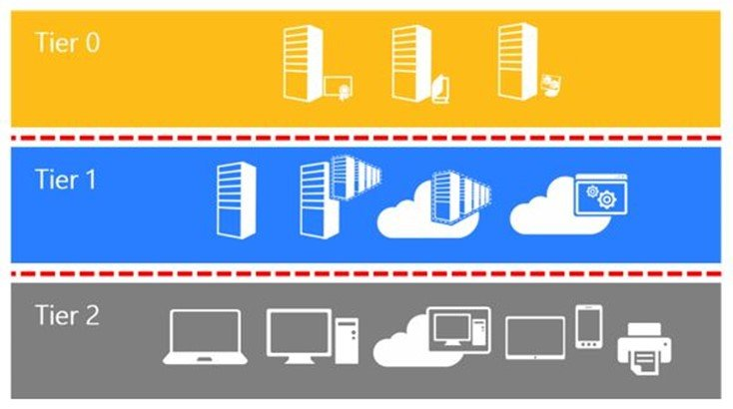
WHY I’M NOT TALKING A LOT ABOUT TIERING
Tiering = Good
Everyone talks about it
No one finishes it
Environments still vulnerable.
Identity / Cloud Admin
MY ADVICE ON TIERING
Service/Application Admin
Start with Tier 0 First
Identify Tier 0 Accounts + Systems
Domain/Identity Level Administrator Rights
Environment-wide Administrative Rights
Dedicated T0 Accounts
Identify Tier 0 Dependencies
Endpoint Admin
BSIDESKC 2026
TYLER JACOBS | POOLMANJIM
Notes:
I like tiering, I do, but it is well covered. Also, organizations tend to get started and never finishing leaving this dumpster fire of access with no path forward. Without a complete version, there are tons of hidden vulnerabilities and a false sense of security.
A quick guide to getting started with tiering:
- Tier 0 should be hardened first. This will contain your most critical accounts so hardening this is a huge risk reduction.
- Identify the systems that should be in Tier 0. This would be accounts that are identity or cloud admins. This is your domain admins, enterprise admins, global admins, and PKI admins and the like. (note: see bonus slide)
- Ensure users who are T0 have dedicated Tier 0 accounts separate from their daily driver.
Find the dependencies. What tools run as system on the Tier 0 systems? Do they need that access? Can they be moved/built in the tier instead?
-- REFERENCES -
Tiering References
https://learn.microsoft.com/en-us/security/privileged-access-workstations/privileged-access-access-model
https://learn.microsoft.com/en-us/security/zero-trust/
https://techcommunity.microsoft.com/blog/coreinfrastructureandsecurityblog/active-directory-hardening-series---part-7-%E2%80%93-implementing-least-privilege/4366626
https://techcommunity.microsoft.com/blog/coreinfrastructureandsecurityblog/protecting-tier-0-the-modern-way/4052851
https://github.com/mon-csirt/active-directory-security/blob/main/MEAM/README.md
https://web.archive.org/web/20190125204946mp_/https://docs.microsoft.com/en-us/windows-server/identity/securing-privileged-access/securing-privileged-access-reference-material
https://learn.microsoft.com/en-us/archive/technet-wiki/37509.active-directory-red-forest-design-aka-enhanced-security-administrative-environment-esae

Slide 68
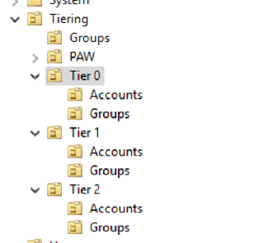
GETTING STARTED WITH TIERING
Deploy Secure Jump Hosts/PAWs (Yep!)
PAWS = Dedicated workstation for T0
Massive Project if correct
SJH = System for managing T0
Start somewhere.
T0 Admins in Protected Users group
Lots of security. Some risk.
Roll out slowly.
No SID-500, Computers, or Services
Please use Dedicated Tier 0 / Control Plane Admins
No email. No Web. Just Admin stuff.
BSIDESKC 2026
TYLER JACOBS | POOLMANJIM
Notes:
This is not a tiering talk so I'm limiting myself here some. Rather than overdoing it and spending three years failing at doing tiering, start with what can be done and then move onto the harder parts. I have more on this in my notes and in the bonus slides but here are some less complicated/super meaningful items to start working on.
Deploy Secure Jump Hosts/PAWs. The real difference in PAWs and jump hosts is the level of hardening and origin. If you're not ready to do a full PAWs deployment, they're almost indistinguishable. PAWs are a big project that rarely gets completed. Secure Jump Hosts work toward the same goal. The idea is eventually to continue working and migrate to a PAW.
(NOTE: Jump Hosts are servers you log into first before logging into the system you manage. PAWs are both a secured host and have a secured origin. If you're not ready to fully secure the entire thing the two are dissimilar.)
2. Tier 0 / Control Plane admins need to be members of Protected Users. This group does lots of hardening but can break stuff, especially old stuff. Roll this out slow over a week or two targeting one or two admins at a time. Don't put your break-glass or Builtin\Admin into this.
-- PAUSE - TIME CHECK…
3. Tier 0 Admins / Control Plane Admins (Domain Admins, Global Admins, etc.) should be split off into separate accounts dedicated to tier 0. No email. No web browsing. Just super admin stuff.
-- NOTES --
I didn’t have time to cover this really in my talk, but when building out a Secure Jump Host, effectively follow the PAWs guidance. The real difference is you aren’t doing a full control of the access path and a dedicated host, etc. The hardening is almost the same otherwise.
-- REFERENCES --
Secure Jump Hosts / PAWS (mostly PAWs)
https://learn.microsoft.com/en-us/windows-server/identity/ad-ds/plan/security-best-practices/implementing-secure-administrative-hosts
https://techcommunity.microsoft.com/blog/microsoft-security-blog/how-to-enforce-usage-of-privileged-access-workstations-for-admins/4067207
https://learn.microsoft.com/en-us/security/privileged-access-workstations/privileged-access-deployment
https://ericonidentity.com/2023/07/17/protect-your-privilege-with-paw/
https://www.ravenswoodtechnology.com/use-privileged-access-workstations-to-increase-security/
heimdalsecurity.com/blog/privileged-access-workstation/
Protected Users Group
https://learn.microsoft.com/en-us/windows-server/security/credentials-protection-and-management/protected-users-security-group
https://www.ravenswoodtechnology.com/understanding-the-active-directory-protected-users-group/
https://github.com/jakehildreth/PowerPUG
Tiering References
https://learn.microsoft.com/en-us/security/privileged-access-workstations/privileged-access-access-model
https://techcommunity.microsoft.com/blog/coreinfrastructureandsecurityblog/active-directory-hardening-series---part-7-%E2%80%93-implementing-least-privilege/4366626
https://techcommunity.microsoft.com/blog/coreinfrastructureandsecurityblog/protecting-tier-0-the-modern-way/4052851
https://github.com/mon-csirt/active-directory-security/blob/main/MEAM/README.md

Slide 69
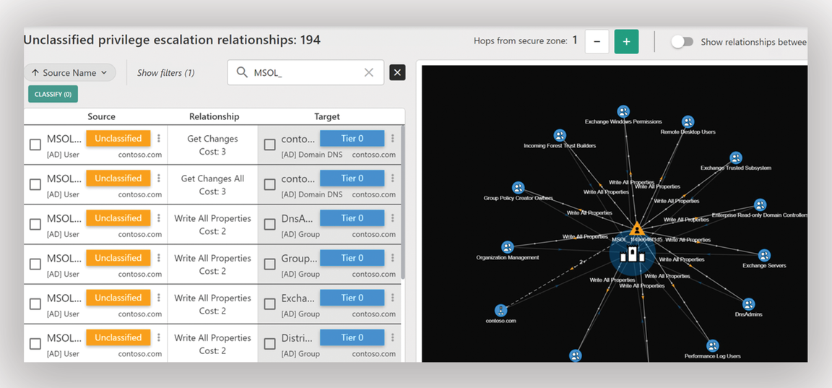
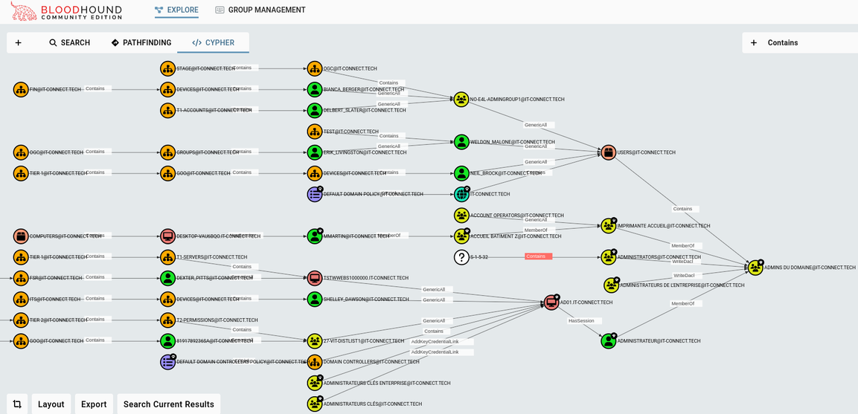
SEMPERIS FOREST DRUID
FINDING TIER 0
Tier 0 Dependency and attack mapping
Semperis Forest Druid
Free - Requires email.
Maps Tier 0 users, groups, etc.
Kind of clunky.
SpectreOps Bloodhound CE
WILL TRIP EDR
The standard T0 Attack Mapping Tool
CE = Community Edition = Free
Paid version available
BLOODHOUND CE
BSIDESKC 2026
TYLER JACOBS | POOLMANJIM
Notes:
Here's a final recommendation to make some of it more approachable. I recommend looking at a tool like ForestDruid by Semperis or even Bloodhound Community Edition from SpectreOps to do some Tier 0 attack path mapping. This will help you identify your super admins in AD and start hardening them.
Note that BloodHound will 100% flag EDR so make sure you're working with your Security teams on this. The same applies to Forest Druid though I haven't seen it trip EDR yet.
Remember all of this is a start. This isn't intended to be comprehensive but intended to get you meaningful wins that can actually get done while you're working on long-term solutions.
-- REFERENCES --
Forest Druid (no email) - https://semperis.com/downloads/tools/fd/ForestDruid-Community.zip
Bloodhount (GitHub) - https://github.com/BloodHound
Adalanche [Alternative to Bloodhound] - https://github.com/lkarlslund/Adalanche

Slide 70
BONUS - More on Tiering
BONUS
Find Tier 0 Dependencies
Remove dependencies. Remove system and admin access not in Tier 0
T0 Password Policy
Complexity + Length + MFA (if possible)
180 day password age
BSIDESKC 2026
TYLER JACOBS | POOLMANJIM
Notes:
-- REFERENCES -
Tiering References
https://learn.microsoft.com/en-us/security/privileged-access-workstations/privileged-access-access-model
https://learn.microsoft.com/en-us/security/zero-trust/
https://techcommunity.microsoft.com/blog/coreinfrastructureandsecurityblog/active-directory-hardening-series---part-7-%E2%80%93-implementing-least-privilege/4366626
https://techcommunity.microsoft.com/blog/coreinfrastructureandsecurityblog/protecting-tier-0-the-modern-way/4052851
https://github.com/mon-csirt/active-directory-security/blob/main/MEAM/README.md
https://web.archive.org/web/20190125204946mp_/https://docs.microsoft.com/en-us/windows-server/identity/securing-privileged-access/securing-privileged-access-reference-material
https://learn.microsoft.com/en-us/archive/technet-wiki/37509.active-directory-red-forest-design-aka-enhanced-security-administrative-environment-esae

Slide 71
AUDIT ACCESS AND ACLS
Most organizations have no idea how bad it is.
Places to Start
Domain Root
Domain Controllers
Privileged Users OUs
Service Accounts OUs
Executive Users OUs
AdminSDHolder
Domain Root \ System \ AdminSDHolder
BSIDESKC 2026
TYLER JACOBS | POOLMANJIM
Notes:
Most organizations do not have an idea of how bad their access is. Many don't even know where to look. 10, 15, or 20 years of AD can lead to a lot of access sprawl.
When doing any kind of hardening with AD it's best start with hardening the places with privileged or VIP access. These tend to be the places the attackers go after. One to specifically point out here is the Executive Users one. [slide]
We think of privilege in the context of AD access and system access. What if someone steals your CEO or CFO’s account? What kind of damage can that cause?
[slide]
-- NOTE --
Places to start
Domain Root (domainDns)
Domain Controllers OU
Privileged Users OU
Service Account OUs.
Executive Users Ous
AdminSDHolder
Path: domain root \ System \ AdminSDHolder
REFERENCES -
ACL / Account Hardening References
https://learn.microsoft.com/en-us/windows-server/identity/ad-ds/plan/security-best-practices/appendix-c--protected-accounts-and-groups-in-active-directory
https://securityboulevard.com/2026/04/shadow-admins-in-active-directory-hidden-privilege-paths-attackers-exploit/
https://www.cyberark.com/resources/threat-research-blog/shadow-admins-the-stealthy-accounts-that-you-should-fear-the-most
https://www.silverfort.com/blog/the-hidden-dangers-of-shadow-admins/
https://learn.microsoft.com/en-us/defender-for-identity/security-posture-assessments/identity-infrastructure
https://learn.microsoft.com/en-us/defender-for-identity/security-posture-assessments/accounts
https://learn.microsoft.com/en-us/defender-for-identity/security-posture-assessments/group-policy

Slide 72
AUDIT ACCESS AND ACLS
Most organizations have no idea how bad it is.
Places to Start
Domain Root
Domain Controllers
Privileged Users OUs
Service Accounts OUs
Executive Users OUs
AdminSDHolder
Domain Root \ System \ AdminSDHolder
Risky Permissions
Full Control (Generic All)
Control Access (CA)
Owner / Change Owner
Reset Password
BSIDESKC 2026
TYLER JACOBS | POOLMANJIM
Notes:
When talking about risky permissions, the focus here is anything that affect ownership or access to an account. The big one is Full Control. 99% of the time stuff doesn’t need full control. Delegate it. Don’t give full control unless you have to.
[slide]
-- NOTE --
Risky Permissions
Full Control (Generic All)
Control Access (CA)
Owner / Change Owner
Reset Password
-- REFERENCES -
ACL / Account Hardening References
https://learn.microsoft.com/en-us/windows-server/identity/ad-ds/plan/security-best-practices/appendix-c--protected-accounts-and-groups-in-active-directory
https://securityboulevard.com/2026/04/shadow-admins-in-active-directory-hidden-privilege-paths-attackers-exploit/
https://www.cyberark.com/resources/threat-research-blog/shadow-admins-the-stealthy-accounts-that-you-should-fear-the-most
https://www.silverfort.com/blog/the-hidden-dangers-of-shadow-admins/
https://learn.microsoft.com/en-us/defender-for-identity/security-posture-assessments/identity-infrastructure
https://learn.microsoft.com/en-us/defender-for-identity/security-posture-assessments/accounts
https://learn.microsoft.com/en-us/defender-for-identity/security-posture-assessments/group-policy

Slide 73
AUDIT ACCESS AND ACLS
Most organizations have no idea how bad it is.
Places to Start
Accounts with Too Much
Domain Root
Domain Users
Authenticated Users
Anonymous Users
Everyone
Domain Computers
Pre-Windows 2000 Group
Domain Controllers
Privileged Users OUs
Service Accounts OUs
Executive Users OUs
AdminSDHolder
Domain Root \ System \ AdminSDHolder
Risky Permissions
Full Control (Generic All)
Control Access (CA)
Owner / Change Owner
Reset Password
BSIDESKC 2026
TYLER JACOBS | POOLMANJIM
Notes:
What are some groups to keep an eye open for? Pretty much, to start, is anything lots of accounts. I listed some of the more common “collective groups”. Make sure you’re looking at what permissions these have.
[slide ]
A notable one here is the Pre-Windows 2000 Compatible Access group. This group by default has lots more permissions than you think. The goal is empty, but at a minimum get it down to domain users or authenticated users if you can.
It's also important to consider what permissions are "risky". These tend to be permissions that can change permissions or reset passwords, etc. I listed a few here, but there are more in the notes.
Consider accounts that encompass a lot of users. These often get added somewhere and lots of users get rights they don't need.
-- NOTE --
Domain Users - All users in a domain. Default user access
Authenticated Users - Domain Users + Users from Trusted Domains
Anonymous Users - Guests
Everyone - All of the Above
Domain Computers - All Computers in the Domain. Default Computer Access
Pre-Windows 2000 Compatible Access Group
This group has Everyone by default in a lot of cases but has been defaulted to Authenticated Users in recent times. Ultimately this group isn’t needed and should be depreciated over time.
It grants too much access by default.

Slide 74
BONUS - More ACL Auditing Guidance
BONUS
Additional Risky Permissions
Replicating Directory Changes
Replicating Directory Changes All
Create/Delete Child Object
writeProperty - UserAccountControl
Replication Rights
Can be leveraged for DCSync Attack
UserAccountControl Rights
Can set things like DON’T_REQUIRE_PREAUTH (AS-REP Roasting)
BSIDESKC 2026
TYLER JACOBS | POOLMANJIM
Notes:
Most organizations have no idea how bad their ACL situation is — and many don't know where to start looking. 10, 15, or 20 years of accumulated AD changes means a lot of skeletons. The places listed on the previous slide are the highest priority starting points : Domain Root, Domain Controllers, AdminSDHolder, and OUs containing privileged or sensitive accounts. Those locations have the most blast radius if something is misconfigured.
On the permissions side the previous slide covered the high-level dangerous ones. Here are a few more worth understanding: Replicating Directory Changes and Replicating Directory Changes All
These two permissions that together enable a DCSync attack. Any account that has both of these on the domain root can pull password hashes for any account in the domain without ever touching a domain controller directly. These permissions are legitimate, replication partners need them, but they should only ever be on accounts that actually do replication. Run your ACL scanner against the domain root and look for anything unexpected holding these.
Create / Delete permissions
These perms on OUs or containers can allow an attacker to create new objects, create new accounts, or delete existing ones. This can lead to persistence and other things.
WriteProperty on userAccountControl
WriteProperty can be dangerous in many scenarios, but on UserAccountControl it is very dangerous. This attribute controls account flags, whether the account is disabled, whether it requires pre-authentication, whether it's trusted for delegation. An attacker with write access to this attribute can set DONT_REQUIRE_PREAUTH on any account and immediately make it an AS-REP Roasting target. They can also disable accounts or set other flags to disrupt the environment.
-- REFERENCES --
DCSYNC
https://www.semperis.com/blog/dcsync-attack/
https://docs.tenable.com/identity-exposure/SaaS/Content/User/AttackPath/DCSync.htm
https://attack.mitre.org/techniques/T1003/006/
UserAccountControl (AS-REP Roasting)
https://www.christopherkeim.com/post/as-rep-roasting-finding-and-fixing-vulnerable-accounts-with-powershell
General ACL Abuse
https://www.ired.team/offensive-security-experiments/active-directory-kerberos-abuse/abusing-active-directory-acls-ace

Slide 75
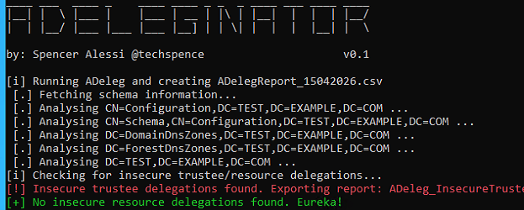
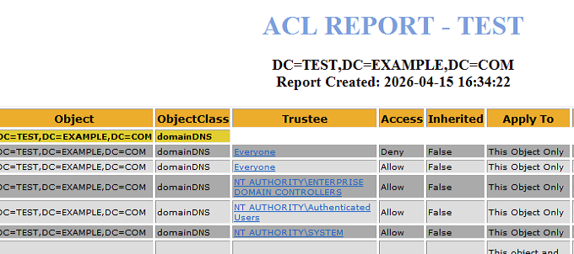
AUDIT ACCESS AND ACLS
Helpful Tools
THESE MAY TRIP EDR/AV
ADDeleginator + ADDeleg
https://github.com/techspence/ADeleginator
AD ACL Scanner
https://github.com/canix1/ADACLScanner
BSIDESKC 2026
TYLER JACOBS | POOLMANJIM
Notes:
The challenge is that there tend to be thousands of accounts, hundred of OUs, and the list goes on. Lucky I found some tools!
- ADDeleginator. This one is written by a pentester friend of mine and it is designed to bring out some of the permissions are are very likely to be exploited. It depends on another tool that is also free.
- AD ACL Scanner. This is another free tool that is more of a general ACL audit of AD. It will give you more of a big picture.
There are other tools too so I encourage you to look into those. Something to keep in mind with all these tools is ACL scans are a common tactic for attackers so EDR will likely flag it. Talk to your cyber team first
-- REFERENCES --
ADDeleginator - https://github.com/techspence/Adeleginator
ADDeleg - https://github.com/mtth-bfft/adeleg/
AD ACL Scanner - https://github.com/canix1/ADACLScanner
ACL / Account Hardening References
https://learn.microsoft.com/en-us/windows-server/identity/ad-ds/plan/security-best-practices/appendix-c--protected-accounts-and-groups-in-active-directory
https://securityboulevard.com/2026/04/shadow-admins-in-active-directory-hidden-privilege-paths-attackers-exploit/
https://www.cyberark.com/resources/threat-research-blog/shadow-admins-the-stealthy-accounts-that-you-should-fear-the-most
https://www.silverfort.com/blog/the-hidden-dangers-of-shadow-admins/
https://learn.microsoft.com/en-us/defender-for-identity/security-posture-assessments/identity-infrastructure
https://learn.microsoft.com/en-us/defender-for-identity/security-posture-assessments/accounts
https://learn.microsoft.com/en-us/defender-for-identity/security-posture-assessments/group-policy

Slide 76
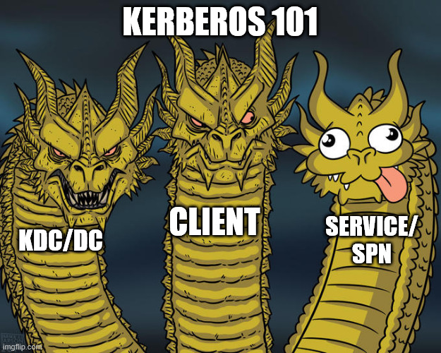
SERVICE ACCOUNT HARDENING
What is a service account?
Any account that runs a service OR has a SPN
SPN = Service Principal Name
Method Kerberos uses to find services
Ex. MSSQLSvc/SQLDB01:1433
BSIDESKC 2026
TYLER JACOBS | POOLMANJIM
Notes:
Service Accounts or in the age of clanker agents pretending to be people, I'm supposed to use the term "non-human identities", but I am talking about service accounts.
My definition is any account that either runs a service (Log on as Service / Se???) or any account with a servicePrincipalName (SPN) (pronoucned Spin)
What is a SPN?
Service Principal Names are how Kerberos identifies services on the network.
- Kerberos = Cerberus which is the three headed dog. Fluffy!
- Head 1 = The client
- Head 2 = The server, or service as I prefer it.
- Head 3 = The KDC or DOmain Controller.
(NOTE: Service Principal Names often look like this: MSSQL\myserverhostname.fqdn:1688)
-- BONUS --
There are a number of attacks that bad service accounts can cause, and, again, I can't list them all here. Most often these attacks derive from either credential harvesting, bad passwords, or lack of access controls.
Service accounts run services and pretty quick become the backbone of the network. SQL is the one I always go on because I think most everyone has at least one story of SQL going down and it being a bad day.
-- REFERENCE
https://www.hipconf.com/resources/how-to-protect-machine-identities/
https://techcommunity.microsoft.com/blog/askds/kerberos-for-the-busy-admin/395083
https://syfuhs.net/a-bit-about-kerberos/2

Slide 77
SERVICE ACCOUNT HARDENING
What is a service account?
Any account that runs a service OR has a SPN
SPN = Service Principal Name
Method Kerberos uses to find services
What do we do?
Identify Service Accounts (see notes)
Replace old Service Account Passwords
Audit + Remediate Account SPNs.
Audit Access and Log On As Service Right
Use MSAs
BSIDESKC 2026
TYLER JACOBS | POOLMANJIM
Notes:
We talked about what they are. Identifying Service Accounts is part of this. Start with the SPN check. If accounts have SPNs, that is a great place to start. Look for accounts in a "Service Accounts" OU. That's just a starting spot though. I have a link in the notes that is a really, really good guide on identifying and securing service accounts.
Service accounts often have static passwords that aren't changed often. Often this includes the accounts having "Password Never Expires" set.
Password Never Expires isn't bad on its own. The bad part is there was never an administrative control to come back, audit accounts, and ensure they get manually reset in a controlled fashion.
This is amplified by the fact that service accounts, but nature are privileged accounts. They tend to be able to do stuff that we wouldn't just want rank-and-file users to do. So now we have a old password, on a privileged account.
Audit the SPNs on accounts. If an account has a SPN and it isn't running as a service, it needs the SPN removed. If it is a primary user account - checks email, etc. - it needs to be migrated to a service account or dedicated to one.
PowerShell to find SPNs
Get-ADUser -LDAPFilter "(servicePrincipalName=*)`
Alternatively if you did use the employee type...
`Get-ADUser -LDAPFilter "(&(servicePrincipalName=*)(employeeType=ServiceAccount))
Check for accounts with Log on as a Service right to systems. If that is being used, figure out why. In general remove user groups from this permission if possible.
Finally use a Managed Service Account
-- REFERENCE
https://www.hipconf.com/resources/how-to-protect-machine-identities/
https://github.com/dcdiagfix/AD-ServiceAccounts-FUNdamentals/blob/main/AD-ServiceAccounts-FUNdamentals.md#identifying-service-accounts-who

Slide 78
BONUS - Identifying Service Accounts
BONUS
Name begins/ends with srv, serv, svc, service, etc. Get-ADUser -LDAPFilter “(|(samAccountName=srv*)(samAccountName=serv*)(samAccountName=svc*)(samAccountName=service*))”
Accounts in an OU titled “Service Accounts”
Get-ADUser -Filter “distinguishedName -like “*OU=Service Accounts*”
Accounts with SPNs
Get-ADUser -LDAPFilter “(servicePrincipalName=*)”
Accounts are members of groups delegated Logon As Service
No tricks here - This is harder to check…
Accounts configured to be trusted for delegation
Get-ADUser -Filter “TrustedForDelegation -eq $true”
Accounts with Password Never Expires set.
Get-ADUser -Filter “PasswordNeverExpires -eq $true”
BSIDESKC 2026
TYLER JACOBS | POOLMANJIM
Notes:
Identifying Service Accounts
This is one of the bigger challenges of service accounts. They often don't have standard naming conventions, especially if having been used for a long time.
Some identifiers that CAN be shared by service accounts:
- Accounts with srv, serv, svc, service, or similar in their name. Get-ADUser -LDAPFilter “(|(samAccountName=srv*)(samAccountName=serv*)(samAccountName=svc*)(samAccountName=service*))”
- Accounts in an OU that is titled "Service Accounts" or something similar. Get-ADUser -Filter “distinguishedName -like “*OU=Service Accounts*”
- Accounts with SPNs Get-ADUser -LDAPFilter “(servicePrincipalName=*)”
- Accounts that are members of groups that specify the "Log on As Service" right.
This one is harder to check. You can either check the group policies for that permission, or audit suspected accounts and see if they have that logon right. Either way there isn’t a one shot powershell to get this.
- Accounts that are trusted for delegation. Get-ADUser -Filter “TrustedForDelegation -eq $true”
- Accounts with Password Never Expires set. Get-ADUser -Filter “PasswordNeverExpires -eq $true”
Finding where service accounts are being used:
- This is a bit more challenging. One of the references includes really good information on this.
- Here is an example SIEM query from one of the references listed in the notes.
index=wineventlog sourcetype=WinEventLog:Security EventCode=4769 Account_Name="*svc*"
| table _time, ComputerName, Account_Name, Service_Name, Ticket_Options, IpAddress, Process_Name
Ongoing Tagging of Service Accounts.
- Have a naming convention for service accounts (serv, svc, srv, etc.)
- Have a dedicated OU in each Tier of OUs for service accounts for all service accounts.
Attribute Identification of Service Accounts
- Another suggestion is to set one or more attributes identifying the account as a service account. This makes sense as it is a little easier to search on than names.
- Examples
-- employeeType. This is a free-text field. You can put something like "Service Account" or "ServiceAccount" or something.
-- flags. This is an integer field that I recommend doing as a binary enum field. Set service account high to make it unique and make it a power of two so it can be checked bitwise. For example, make the 8192 value mean service account.
When you identify something is truly a service account, mark it as such so this becomes easier later.
- There is an attribute in AD called flags that isn't used. It is an integer, so treat it like an enum and make every service account increment that field by +8192.
- Another field is attribute is employeeType. This one is a string. Just put Service Account in there.
- If those are used, you'll have to get creative.
Next, find any account that ISN'T a computer or a known service account that has a servicePrincipalName and either make it a service account or get it a dedicated service account to run that service. Then go in and block everyone but actual service accounts from Log on as Service.
Cap it all off with the fact that a particular segment of attacks exploits vulnerable passwords to generate arbitrary kerberos authorizations (yep, authorizations) \[Kerberosting] and next thing you know that business critical service account has become a critical vulnerability.
-- REFERENCES --
https://github.com/dcdiagfix/AD-ServiceAccounts-FUNdamentals/blob/main/AD-ServiceAccounts-FUNdamentals.md#identifying-service-accounts-who

Slide 79
BONUS - Locating Service Account Usage
BONUS
Harder than identifying
Involves reviewing logon events and narrowing it down.
Example SIEM Query (may not work on all SIEMs)
index=wineventlog sourcetype=WinEventLog:Security EventCode=4769 Account_Name="*svc*"
| table _time, ComputerName, Account_Name, Service_Name, Ticket_Options, IpAddress, Process_Name
BSIDESKC 2026
TYLER JACOBS | POOLMANJIM
Notes:
BONUS - Locating Service Account
Finding where service accounts are being used:
- This is a bit more challenging. One of the references includes really good information on this.
- Here is an example SIEM query from one of the references listed in the notes.
index=wineventlog sourcetype=WinEventLog:Security EventCode=4769 Account_Name="*svc*"
| table _time, ComputerName, Account_Name, Service_Name, Ticket_Options, IpAddress, Process_Name
-- REFERENCES --
https://github.com/dcdiagfix/AD-ServiceAccounts-FUNdamentals/blob/main/AD-ServiceAccounts-FUNdamentals.md#identifying-service-accounts-who

Slide 80
BONUS - Ongoing Tagging of Service Accounts
BONUS
How do you keep track of them after finding them?
1. Create and develop a naming convention for all service accounts.
srv_MyService servMyService
2. Have a dedicated Service Account OU for each tier of accounts.
OU=Service Accounts, OU=T0 Accounts, OU=Tier 0, OU=Privileged Admin, $DomainDN
Attribute Identification of Service Accounts
Choose an attribute that isn’t used and store this information.
Avoid extensionAttributes. They’re overused
Avoid attributes that otherwise have other uses. (e.g.; pager, organization, etc.)
Recommended attributes
employeeType = Free text. Put Service Account in it for service accounts.
Flags = Integer value. Use a binary enum with each power of 2 representing an account type.
BSIDESKC 2026
TYLER JACOBS | POOLMANJIM
Notes:
Ongoing Tagging of Service Accounts.
- Have a naming convention for service accounts (serv, svc, srv, etc.)
- Have a dedicated OU in each Tier of OUs for service accounts for all service accounts.
Attribute Identification of Service Accounts
- Another suggestion is to set one or more attributes identifying the account as a service account. This makes sense as it is a little easier to search on than names.
- Examples
-- employeeType. This is a free-text field. You can put something like "Service Account" or "ServiceAccount" or something.
-- flags. This is an integer field that I recommend doing as a binary enum field. Set service account high to make it unique and make it a power of two so it can be checked bitwise. For example, make the 8192 value mean service account.
When you identify something is truly a service account, mark it as such so this becomes easier later.
- There is an attribute in AD called flags that isn't used. It is an integer, so treat it like an enum and make every service account increment that field by +8192.
- Another field is attribute is employeeType. This one is a string. Just put Service Account in there.
- If those are used, you'll have to get creative.
Next, find any account that ISN'T a computer or a known service account that has a servicePrincipalName and either make it a service account or get it a dedicated service account to run that service. Then go in and block everyone but actual service accounts from Log on as Service.
Cap it all off with the fact that a particular segment of attacks exploits vulnerable passwords to generate arbitrary kerberos authorizations (yep, authorizations) \[Kerberosting] and next thing you know that business critical service account has become a critical vulnerability.
-- REFERENCES --
https://github.com/dcdiagfix/AD-ServiceAccounts-FUNdamentals/blob/main/AD-ServiceAccounts-FUNdamentals.md#identifying-service-accounts-who

Slide 81
MANAGED SERVICE ACCOUNTS
sMSAs = Standalone MSAs
Don’t use
gMSAs = Group Managed Service Accounts
Manage their own password + SPN
Non-Interactive
Multi-System
Harder to Kerberoast
Windows Only
BSIDESKC 2026
TYLER JACOBS | POOLMANJIM
Notes:
(NOTE: I'm skipping right over standalone MSAs as they really aren't used. They're mostly gMSAs that only work on single systems and aren't nearly as useful so they don't get much love.)
I hate the naming of these. Microsoft loves "Group" when it really already used that word.
The big features of gMSAs
- Self-Managed Psswords (No know one even knows it)
- Self-SPN management.
- Not easily Kerbroastable (Can't be spoofed)
- Non-Interactive
These, as compared to the standalone MSAs, can be used on multiple systems. This is done through an attribute that effectively includes every system allowed to retrieve their password, which is stored and encrypted in some fun ways on the account.
You 100% should be using gMSAs. No excuses. They can be used on multiple computers, they manage their own passwords, they can be access controlled with groups, they manage their own SPNs (usually), and so on. They're awesome.
The biggest downsides to these is you have to make sure you control the setting that allows for retrieving the managed password and keep the riff-raff out, they do not work with other operating systems (officially), and some apps want to have a physical password so they don't support gMSAs. This last one is surprising common considering how long gMSAs have been kicking around already.
They aren't perfect and they can still be abused, but they reduce the attack surface on those accounts significantly. I highly recommend using them wherever you can.
-- REFERENCES
gMSA Reference
- https://learn.microsoft.com/en-us/windows-server/identity/ad-ds/manage/group-managed-service-accounts/group-managed-service-accounts/group-managed-service-accounts-overview

Slide 82
MANAGED SERVICE ACCOUNTS
sMSAs = Standalone MSAs
Don’t use
gMSAs = Group Managed Service Accounts
Manage their own password + SPN
Non-Interactive
Multi-System
Harder to Kerberoast
Windows Only
dMSAs = Delegated Managed Service Accounts
New in 2025
Link old Service Accounts with dMSA = gMSA for unsupported apps.
BadSuccessor = :(
Server 2025 = Kind of sketchy still
BSIDESKC 2026
TYLER JACOBS | POOLMANJIM
Notes:
dMSAs = Delegated Managed Service Accounts
Okay, I want to mention these because they are straight up black magic and love it. These take gMSAs to a whole new level.
I'm not going to go super in depth on these as 1) I have only tested them in labs and 2) they're so new that really very few people are going to be looking at them yet. In my notes there is a link to a talk at HIP 2025 where an MVP goes into detail on all the MSA types that is straight gold.
dMSAs require Server 2025 and the new Server 2025 functional levels in Active Directory. Yes Microsoft is still putting effort into AD after all these years. We're not dead yet!
That is honestly their major downside. Well that and BadSuccessor which was a pretty gnarly vulnerability that came out for them like right after they were released. The vulnerability is improper access controls in AD so with proper access controls it is heavily mitigated.
The short version of them is that look and behave similar to gMSAs except they are linked to a traditional (full user) service account. Whenever that service account's password is authenticated on the network, AD intercepts that and does a validation of the machine identity and some other wizardry. If it passes, AD swaps the access using the dMSA behind the scenes and does the authentication. Effectively this gives the same effect of having a gMSA without the trouble of actually setting up on end systems.
I encourage you to keep an eye on dMSAs as much as you can and get comfortable with them.
-- REFERENCES
- https://www.hipconf.com/resources/demystifying-managed-service-accounts-best-practices-security-measures-to-reduce-risk-and-impact/
dMSA References
- https://learn.microsoft.com/en-us/windows-server/identity/ad-ds/manage/delegated-managed-service-accounts/delegated-managed-service-accounts-overview
- https://jorgequestforknowledge.wordpress.com/2025/07/11/how-to-block-badsuccessor-the-good-bad-and-ugly-of-dmsa-migration/
- https://jorgequestforknowledge.wordpress.com/2025/09/02/from-badsuccessor-to-patchedsuccessor/
- https://jorgequestforknowledge.wordpress.com/2025/05/25/reviewing-your-delegation-model-before-introducing-w2k25-dcs-and-enhancing-security-due-to-badsuccessor/

Slide 83
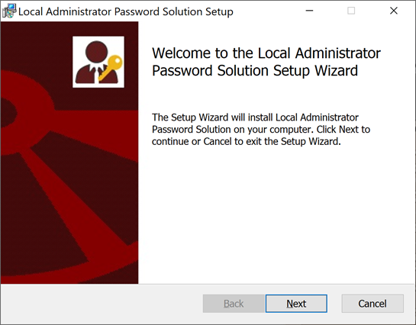
LOCAL ADMINISTRATOR ACCOUNT HARDENING
LAPS = Local Administrator Password Solution
Legacy = Okay
Windows LAPS = Great! (W10/2016+)
Requires Schema Update (not scary)
ONLY the SID-500 Administrator
Local Administrator Group Hardening
Remove Domain Admins from Local Admins
Create GPOs to Block Priv. Logons to Clients
Remove users from Admins
Hard but worth it.
See notes for alternatives.
BSIDESKC 2026
TYLER JACOBS | POOLMANJIM
Notes:
Okay, another show of hands.
- Who here has heard of LAPS, Local Administrator Password Solution?
- Who here has actually deployed it?
- Who here knows Microsoft overhauled it a couple years ago?
The problem LAPS solves is that organizations are lazy. Every local admin is created with the same local administrator password in provisioning and rarely are they disabled, even then they can be easily un-disabled as part of Windows Recovery.
LAPS used to be an installation that you had to download and install. Now it is *mostly* included with Windows. LAPS has an agent (transparent now) that coordinates with AD and stores the password in Active Directory for the local admin. AND ONLY THE LOCAL ADMIN (SID-500)
For this to work you do need to run a command to extend the AD Schema to include the LAPS attributes. This is required whether you use old LAPS or new LAPS but the attributes are different (there's a good reason, even I kind of hate it). It used to be stored plain-text and used access controls to secure it. With New LAPS it is better.
Another feature worth mentioning with New LAPS is it can be configured to auto-rotate the passwords when they are used rather than just on a schedule. This is a big deal. It's almost like Microsoft knows how to do PAM...
I have some notes and links in the slides that go into more. The short version of it is, if you're not using LAPS or a LAPS-like solution, you need to start doing that yesterday. It's not hard to manage.
#### Local Administrator Hardening - Local Admins
While we are on the topic of local admins here are a couple of things I am going to recommend to really move that security bar forward.
1. Remove domain admins, enterprise admins, and the domain builtin administrator account (and group) from all systems' local admins. You can do this with Group Policy. Create other administrative groups and restrict your super-privileged users from logging in everywhere.
2. Start blocking priv logons to systems via GPO.
3. Remove any users you can from local admins. I know scrooge says that it allows him to have a smaller help desk, but day-to-day users don't need to be full time domain admins. Even if you're nuts and allowing them to look up the LAPS password to do stuff, it is better than them having sitting local admin.
#### Tools to Consider
Lithnet came up once before in this talk and here they are again. They have a couple of products that I think are worth looking at.
Lithnet Access Manager has a free mode that is limited but for SMBs it may actually be enough. It can do some access delegations and is really helpful.
> MORE?
Lithnet RapidLAPS is their answer to old LAPS. It adds some features that Microsoft later added in new LAPS, but they also support an app that streamlines a lot of it. It is worth looking into.
-- REFERENCES --
https://learn.microsoft.com/en-us/windows-server/identity/laps/laps-overview
Legacy LAPS
https://www.microsoft.com/en-us/download/details.aspx?id=46899
https://activedirectorypro.com/microsoft-laps-setup-install-guide/
https://learn.microsoft.com/en-us/windows-server/identity/laps/laps-scenarios-migration
Windows LAPS
https://learn.microsoft.com/en-us/windows-server/identity/laps/laps-concepts-overview
https://learn.microsoft.com/en-us/windows-server/identity/laps/laps-scenarios-windows-server-active-directory
https://learn.microsoft.com/en-us/windows-server/identity/laps/laps-management-policy-settings
Lithnet Access Manager + RapidLAPS
https://lithnet.io/products/access-manager
https://lithnet.io/products/access-manager/rapidlaps
https://docs.lithnet.io/ams/installation/getting-started
(Download) https://github.com/lithnet/access-manager

Slide 84
LOCAL ADMINISTRATOR ACCOUNT HARDENING
LAPS = Local Administrator Password Solution
Legacy = Okay
Windows LAPS = Great! (W10/2016+)
Requires Schema Update (not scary)
ONLY the SID-500 Administrator
Local Administrator Group Hardening
Remove Domain Admins from Local Admins
Create GPOs to Block Priv. Logons to Clients
Remove users from Admins
Hard but worth it.
BSIDESKC 2026
TYLER JACOBS | POOLMANJIM
Notes:
1. Remove domain admins, enterprise admins, and the domain builtin administrator account (and group) from all systems' local admins. You can do this with Group Policy. Create other administrative groups and restrict your super-privileged users from logging in everywhere.
2. Start blocking priv logons to systems via GPO.
3. Remove any users you can from local admins. I know scrooge says that it allows him to have a smaller help desk, but day-to-day users don't need to be full time domain admins. Even if you're nuts and allowing them to look up the LAPS password to do stuff, it is better than them having sitting local admin.
-- REFERENCES --
https://learn.microsoft.com/en-us/windows-server/identity/laps/laps-overview
Legacy LAPS
https://www.microsoft.com/en-us/download/details.aspx?id=46899
https://activedirectorypro.com/microsoft-laps-setup-install-guide/
https://learn.microsoft.com/en-us/windows-server/identity/laps/laps-scenarios-migration
Windows LAPS
https://learn.microsoft.com/en-us/windows-server/identity/laps/laps-concepts-overview
https://learn.microsoft.com/en-us/windows-server/identity/laps/laps-scenarios-windows-server-active-directory
https://learn.microsoft.com/en-us/windows-server/identity/laps/laps-management-policy-settings
Lithnet Access Manager + RapidLAPS
https://lithnet.io/products/access-manager
https://lithnet.io/products/access-manager/rapidlaps
https://docs.lithnet.io/ams/installation/getting-started
(Download) https://github.com/lithnet/access-manager

Slide 85
LOCAL ADMINISTRATOR ACCOUNT HARDENING
LAPS = Local Administrator Password Solution
Legacy = Okay
Windows LAPS = Great! (W10/2016+)
Requires Schema Update (not scary)
ONLY the SID-500 Administrator
Local Administrator Group Hardening
Remove Domain Admins from Local Admins
Create GPOs to Block Priv. Logons to Clients
Remove users from Admins
Hard but worth it.
Lithnet Access Manager + Lithnet RapidLAPS
Freemium (5 roles + 100 accounts)
Include some features not in Microsoft’s offering
BSIDESKC 2026
TYLER JACOBS | POOLMANJIM
Notes:
Lithnet Access Manager has a free mode that is limited but for SMBs it may actually be enough. It can do some access delegations and is really helpful.
> MORE?
Lithnet RapidLAPS is their answer to old LAPS. It adds some features that Microsoft later added in new LAPS, but they also support an app that streamlines a lot of it. It is worth looking into.
-- REFERENCES --
https://learn.microsoft.com/en-us/windows-server/identity/laps/laps-overview
Legacy LAPS
https://www.microsoft.com/en-us/download/details.aspx?id=46899
https://activedirectorypro.com/microsoft-laps-setup-install-guide/
https://learn.microsoft.com/en-us/windows-server/identity/laps/laps-scenarios-migration
Windows LAPS
https://learn.microsoft.com/en-us/windows-server/identity/laps/laps-concepts-overview
https://learn.microsoft.com/en-us/windows-server/identity/laps/laps-scenarios-windows-server-active-directory
https://learn.microsoft.com/en-us/windows-server/identity/laps/laps-management-policy-settings
Lithnet Access Manager + RapidLAPS
https://lithnet.io/products/access-manager
https://lithnet.io/products/access-manager/rapidlaps
https://docs.lithnet.io/ams/installation/getting-started
(Download) https://github.com/lithnet/access-manager

Slide 86
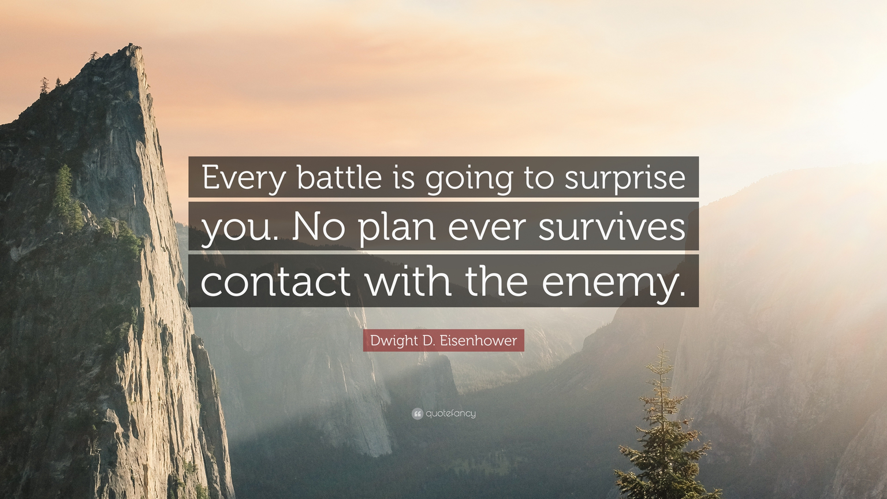

ACTION PLAN + IMPLEMENTATION
Dave Ramsey Scrooge McDuck Approach
Backups - Get them now.
Baselines - Start with low impact
Harden Tier 0 Admins
Reset Old Passwords - 365 days+
Harden Users with SPNs - Fix or harden.
Deploy LAPS
Audit Policies + Start ACL Audits
BSIDESKC 2026
TYLER JACOBS | POOLMANJIM
Notes:
There is a Dave Ramsey... I mean Scrooge McDuck approach here that fits. Do what you can get done first. Make sure the items that need time are put in the approval change ASAP to move them.
1. Backups - Get backups running and stored somewhere. Work on resiliency and immutability of the backups later. Make sure they're secure from unwanted access though.
2. Security Baselines - Focus on Low Impact items and High-Risk Items First. If it is going to take longer than a week or two to get implemented, get it on a project list. Do your Domain Controllers/T0 first, then workstations, then servers.
3. Tier 0 Administrator Hardening - Harden the Tier 0 Admins. This should be a small group (hopefully) and won't have big impacts. This also means give them their own accounts.
4. Reset Old Passwords - Find users with passwords older than 365 days. Start working on getting them reset. This defies NIST some but at this point we're thinking these passwords aren't 16 characters.
5. Harden Users with Service Principal Names - Either remove the SPN and get them a service account or harden the heck out of that user. This may take some time, but it is worth it.
6. Deploy LAPS - This really doesn't take long, and you can enable per system via GPO so it can be phased in.
7. Get Audit Policies enabled and start auditing the ACLs.
Most of those items are fairly low barriers to start. They may take a week or two to get running but you will get wins.

Slide 87
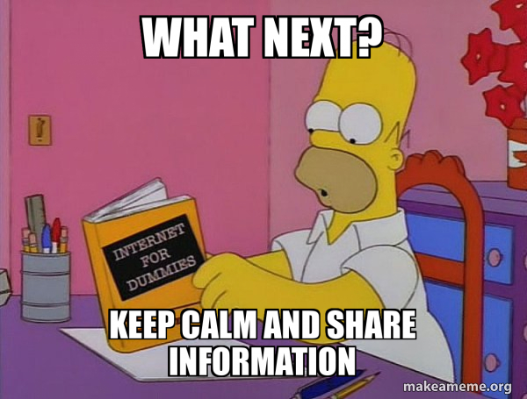
NEXT STEPS
Action Plan Done. Now what?
Run Purple Knight or Ping Castle + Do Fixes
If running AD CS, run Locksmith.
Automate SCAP Scans + Remediate.
Review Backups + Improve.
Bigger Projects
More Tiering
More Baseline Settings (Higher Impact)
PAWs Project
PAM Solutions (not Miser-friendly)
...
BSIDESKC 2026
TYLER JACOBS | POOLMANJIM
Notes:
Once you've finished the items I've already talked about or have them rolling forward start thinking of where to go.
Next, look into tools like PurpleKnight or PingCastle to get a general AD health assessment. If you're running PKI using AD CS, make sure you run Locksmith it is pretty much the go-to PKI auditing tool.
Start looking at making sure your backups are perfect and reliable and immutable.
Move onto bigger and harder projects. Keep hammering at the baselines, look into a full AD/Cloud Tiering Project, and maybe start looking into PAM solutions (Not Scrooge Friendly).
-- REFERENCES --
PurpleKnight - https://semperis.com/downloads/tools/pk/PurpleKnight-Community.zip
PingCastle - https://www.pingcastle.com/download/
Locksmith - https://github.com/jakehildreth/Locksmith
SCAP - https://www.cyber.mil/stigs/SCAP

Slide 88








Resources + Links
Deck will be on Github soon
r/ActiveDirectory Wiki
https://www.reddit.com/r/ActiveDirectory/wiki
Connect
Discord: @Poolmanjim
Reddit: u/Poolmanjim
LinkedIn: linkedin.com/in/thetylerjacobs
GitHub: github/activedirectorykc
Website: activedirectorykc.net
I’ll be over there - With some stickers
HTTPS://GITHUB.COM/ACTIVEDIRECTORYKC
QUESTIONS?
HTTPS://LINKEDIN.COM/IN/THETYLERJACOBS
BSIDESKC 2026
TYLER JACOBS | POOLMANJIM
Notes:
I covered a lot. It's okay to feel overwhelmed. Take it one item at a time and move the security bar forward.
Lastly, resources. I broke the slide rule with lots of links, I'm sorry.
- The notes will be published later today on my Github. The QR code will take you to my Github.
- I have tons of bonus slides so they will cover way more than I covered here.
- Check out the r/ActiveDirectory subreddit, especially the wiki. There are tons of resources there. Share these resources far and wide, just attribute the work to the creators.
- Connect with me if you're interested. I'm on Discord until it isn't cool anymore, but you can find me on Reddit and LinkedIn. You can email me, but I suck at responding so good luck.
- Ask me about AD stuff, Identity, or PowerShell. Also, I love chatting D&D and how I've been using LLMs to make me a better DM.
- Finally, I have your attention. Do something good for the world. If its little, it still matters. Something you can do that could really change at least one life is sign up to be a bone marrow donor. Hit me up if you have questions about any of that.
- OH. I have a few stickers so if you're into that sort of things, come find me over there after this is done if you want one.
God Bless!
QnA
The plan was to have a couple of minutes at least so hit me with any questions you have. I'll do my best or make something up. Regardless come find me if you want to chat any of this stuff, I love talking AD.
-- REFERENCES --
Reddit AD Wiki: https://www.reddit.com/r/ActiveDirectory/wiki
LinkedIn: linkedin.com/in/thetylerjacobs
Website/Blog: activedirectorykc.net
Discord: @Poolmanjim
Reddit u/poolmanjim

